Slide 1
Transaction data loading using infocube.
Milind Parab

Slide 2
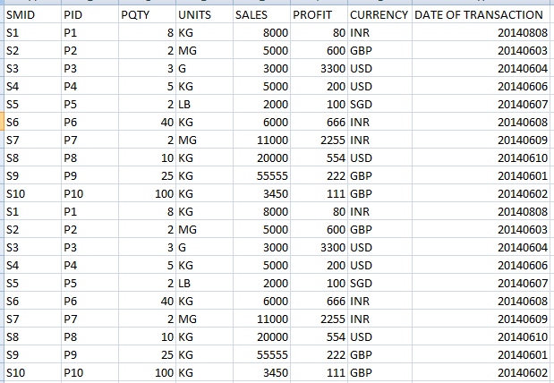
Data in FF.

Slide 3
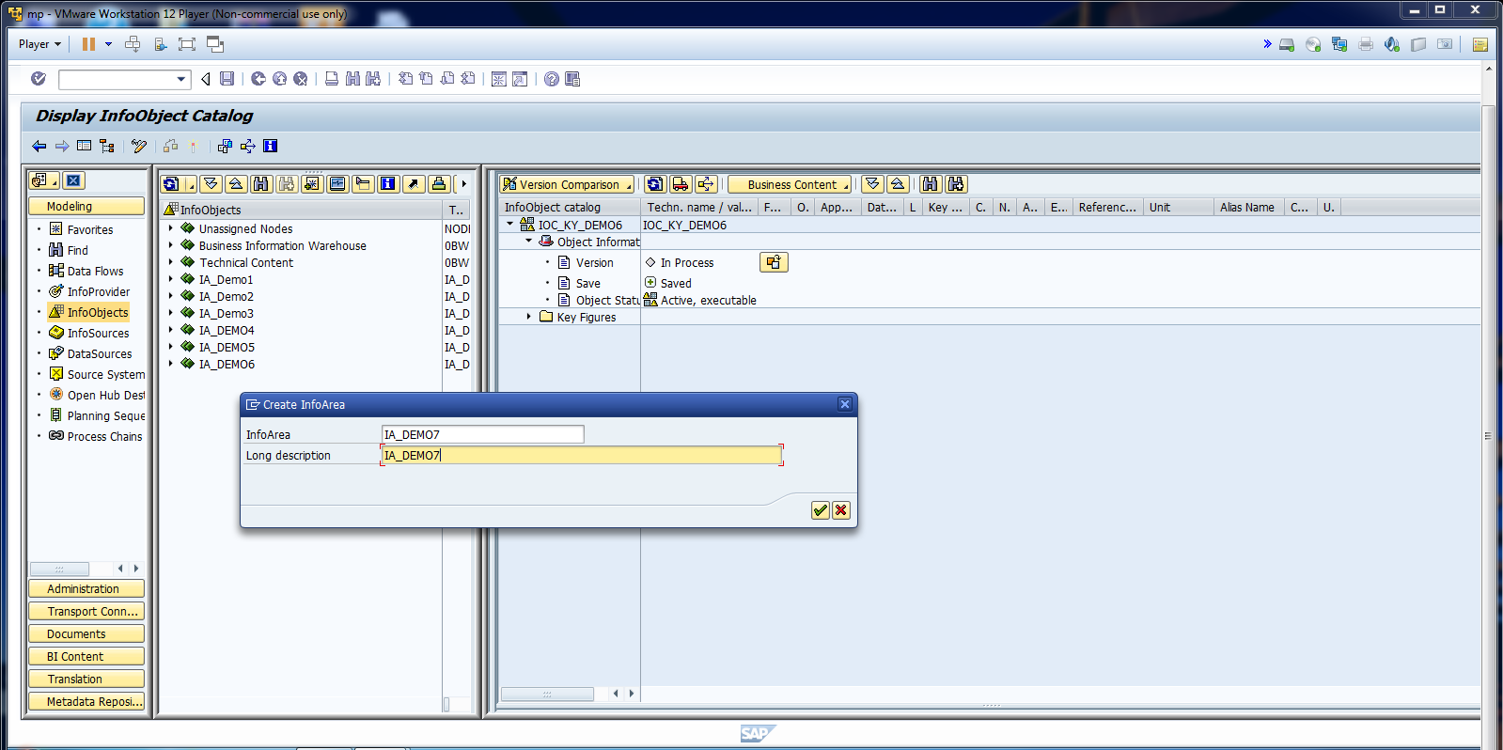
Create Info Area for KIO.

Slide 4
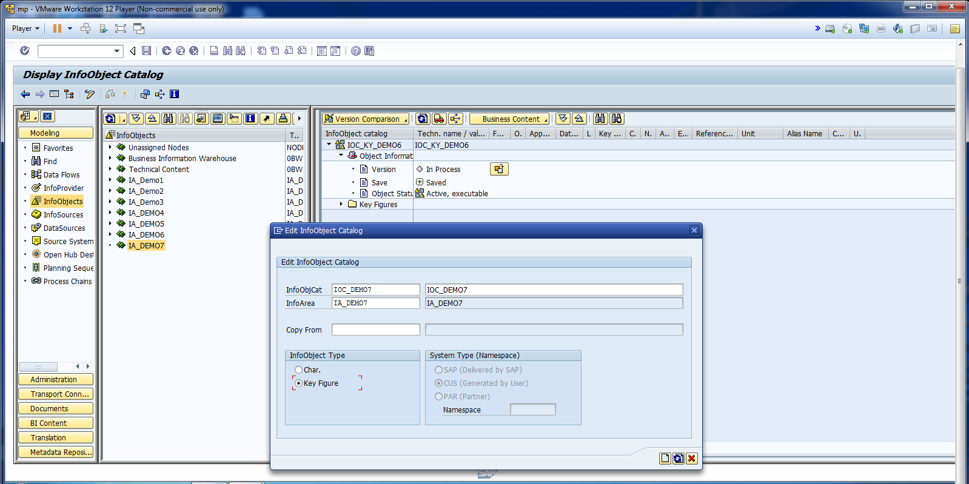
Create IOC for key figure.

Slide 5
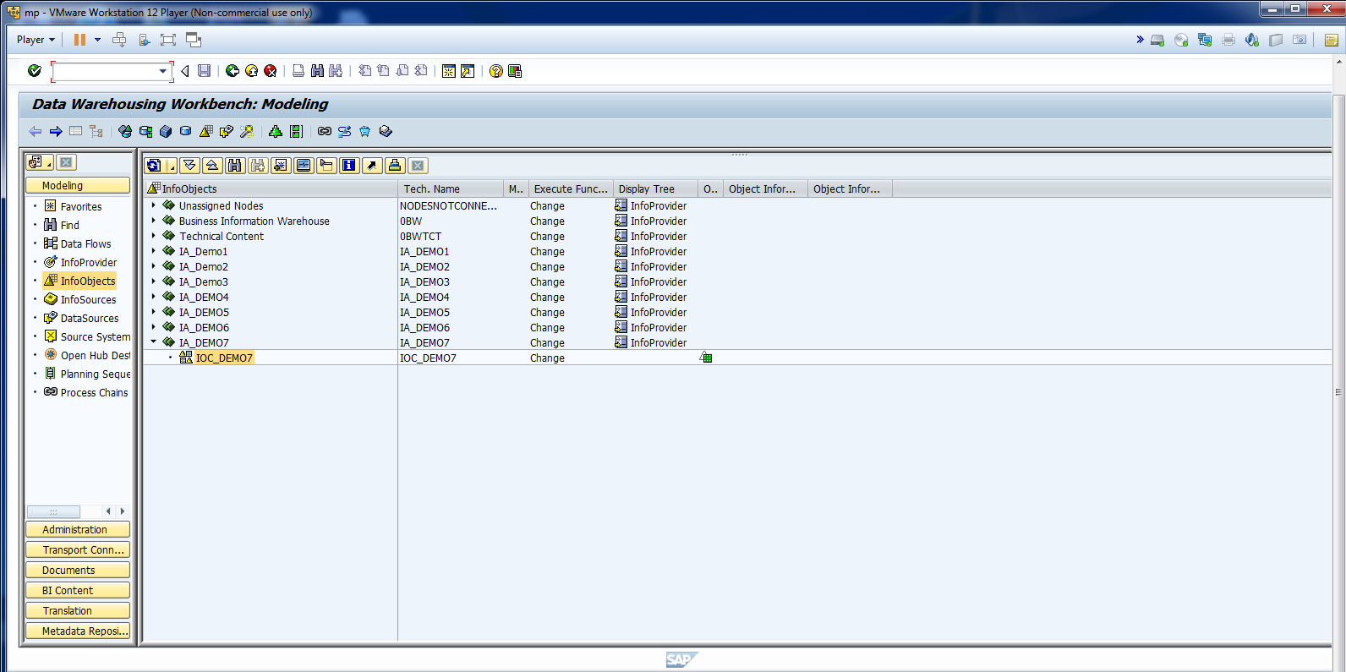
Activate IOC.

Slide 6
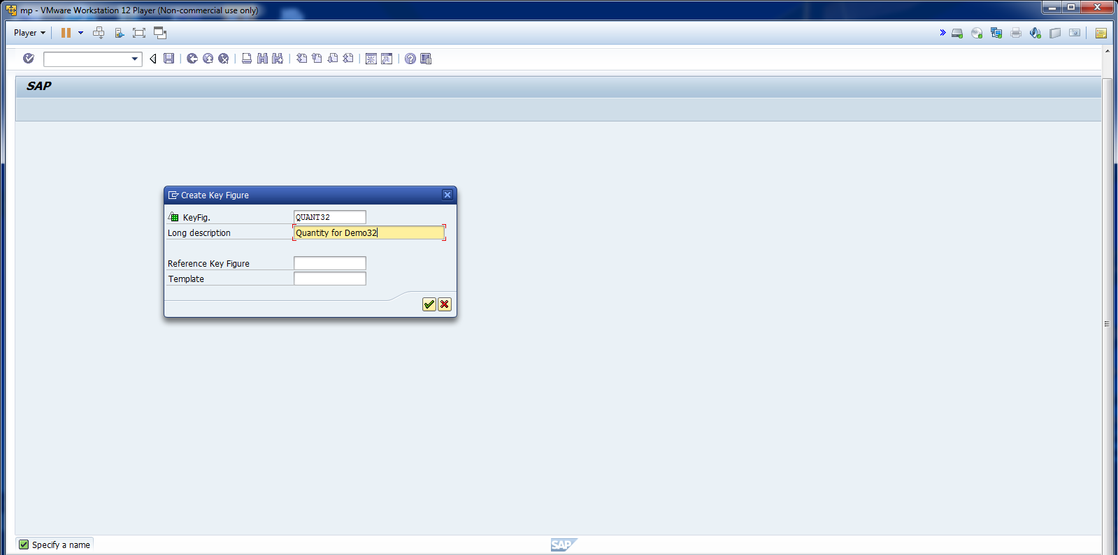
Create Key Figure IO.

Slide 7
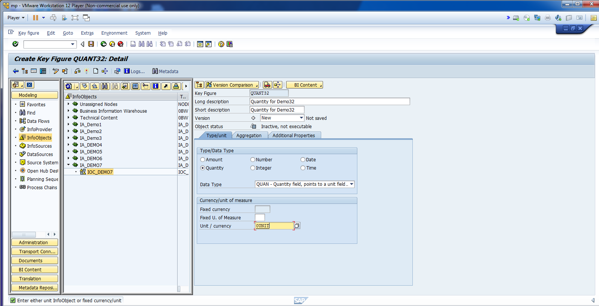
Create Key Figure IO.

Slide 8
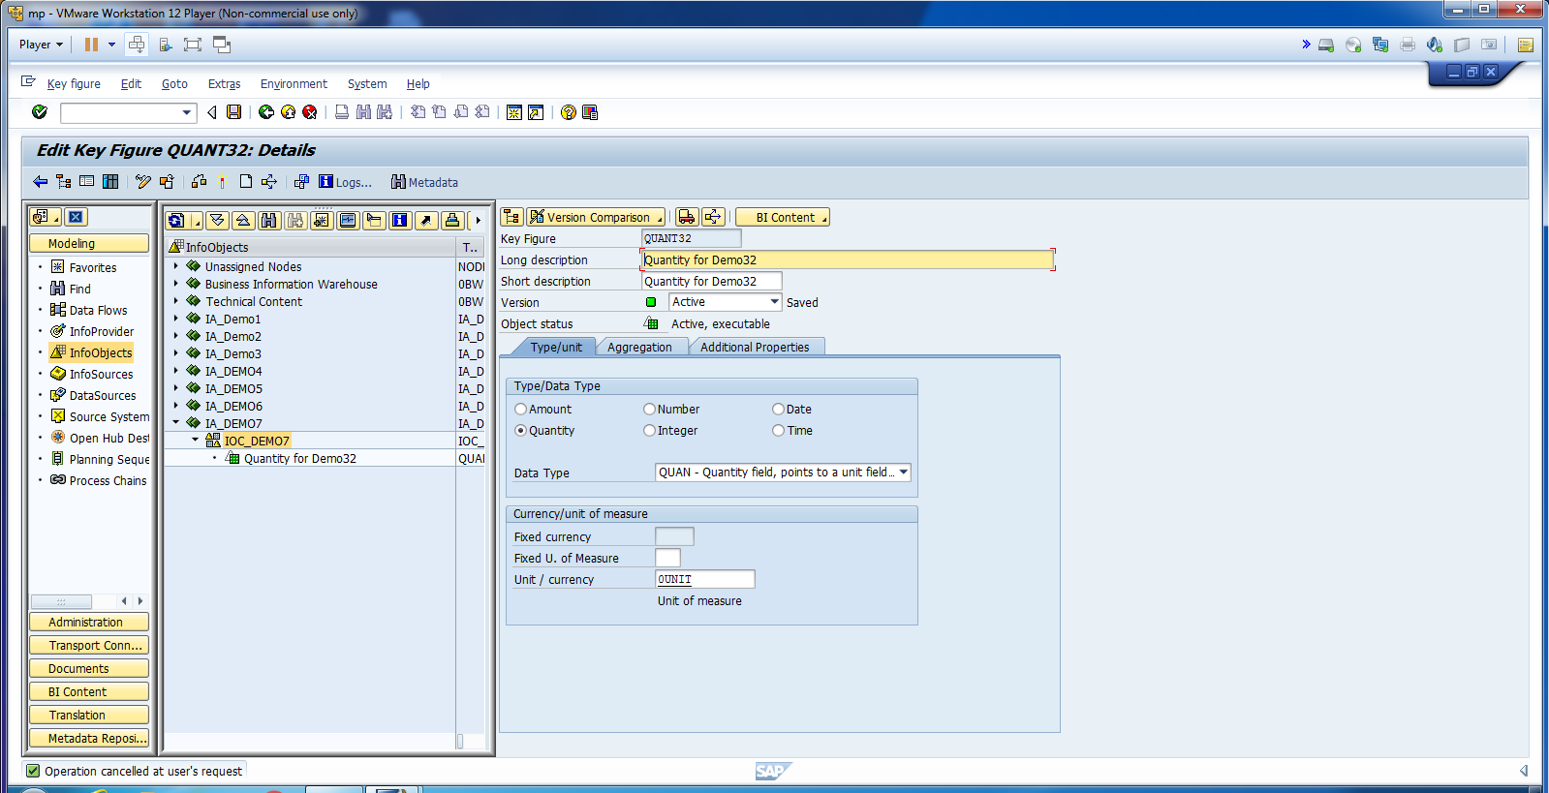
Activate Key Figure IO.

Slide 9
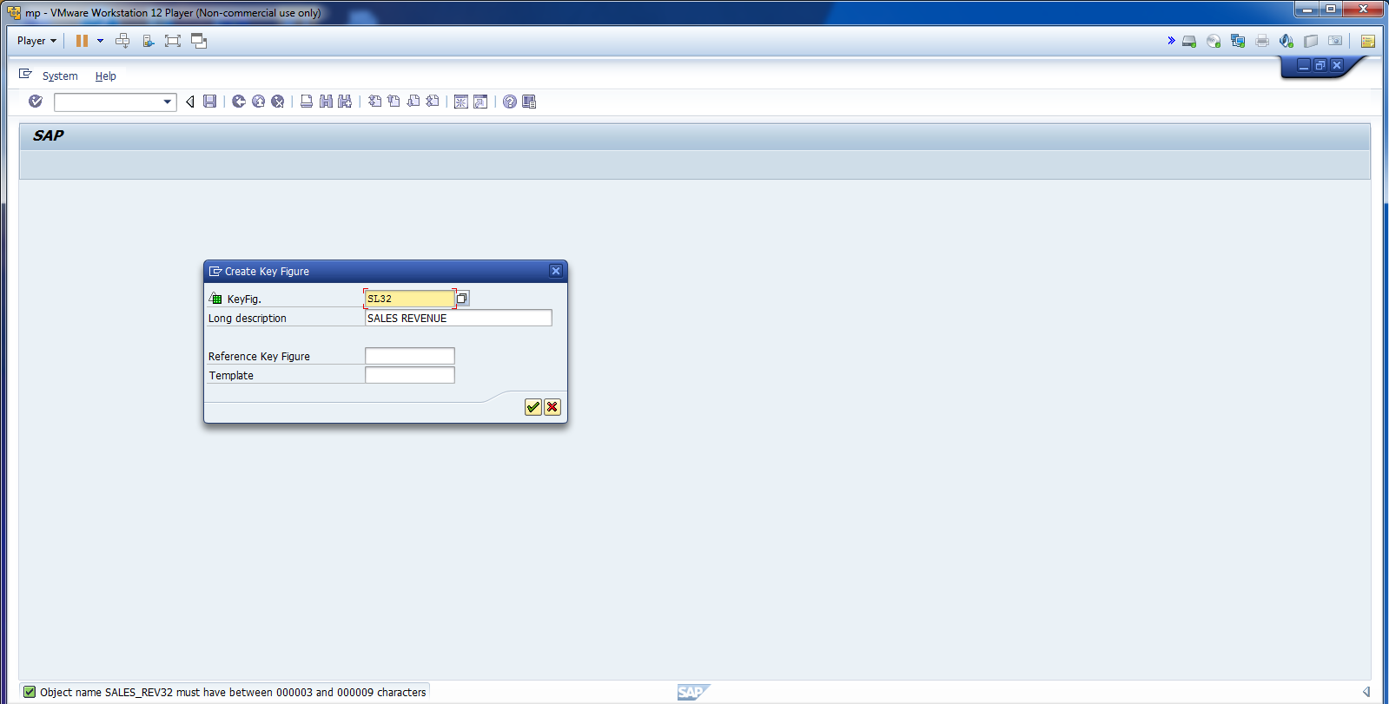
Create another KIO.

Slide 10
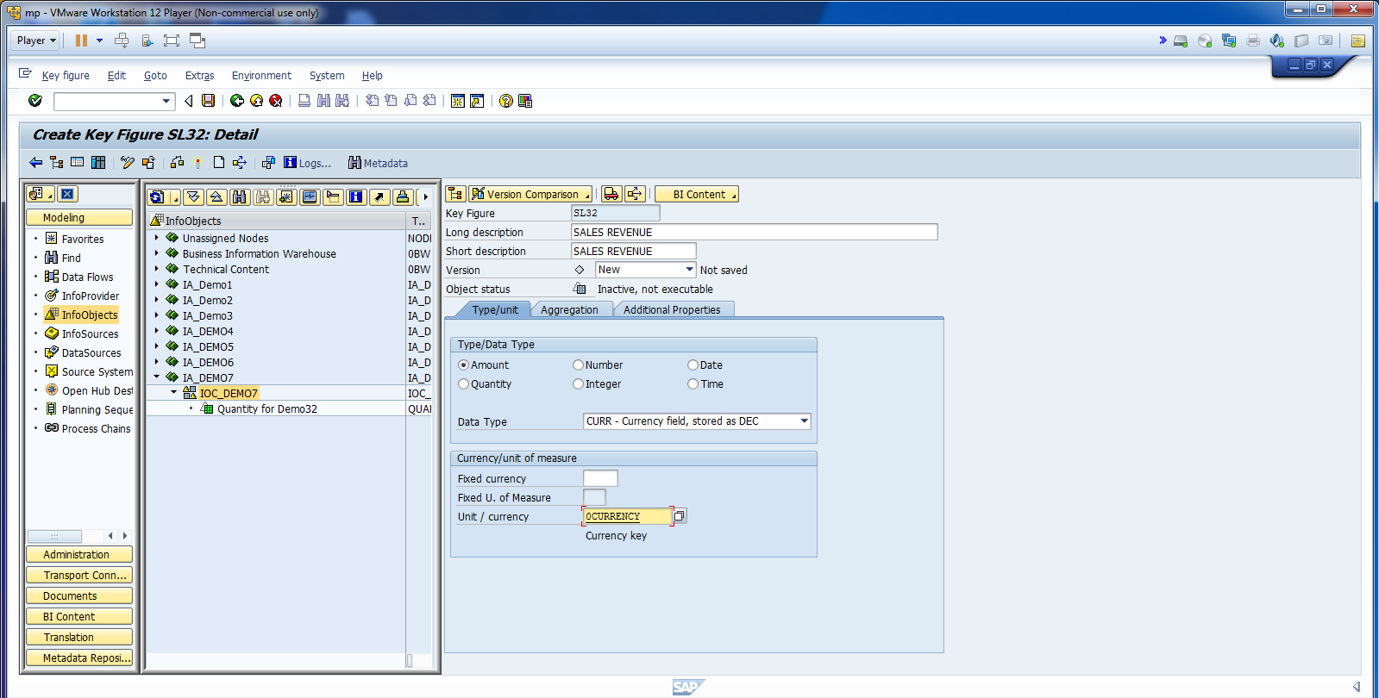
Cont.

Slide 11
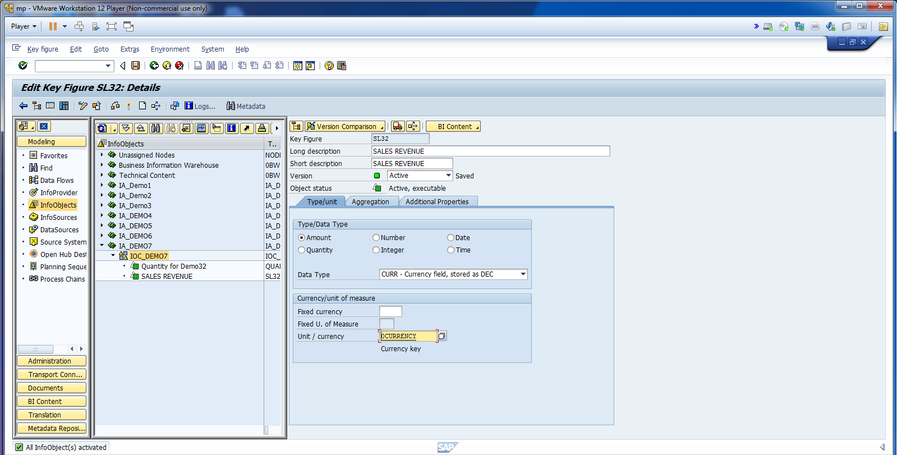
Activate KIO.

Slide 12
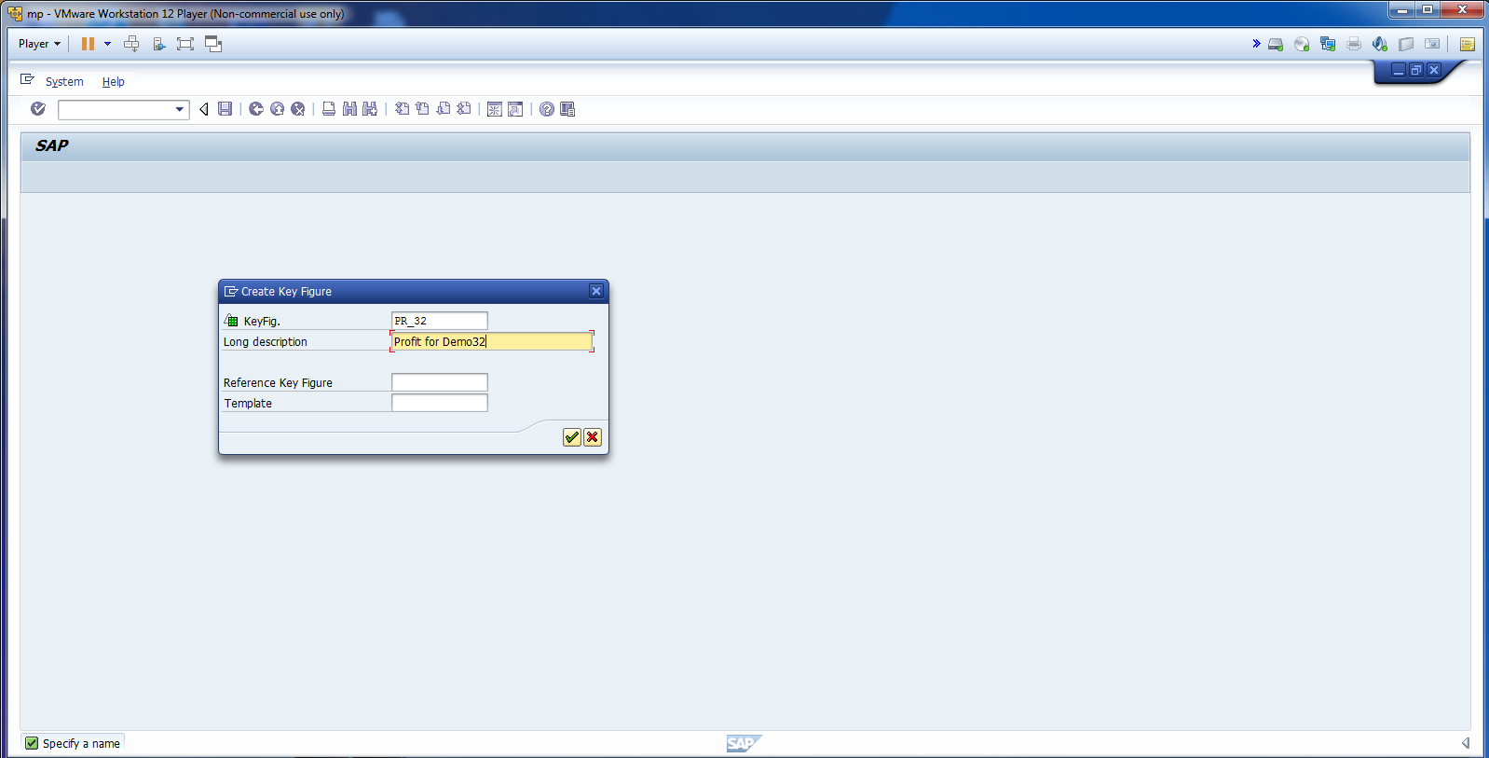
Create Profit KIO.

Slide 13
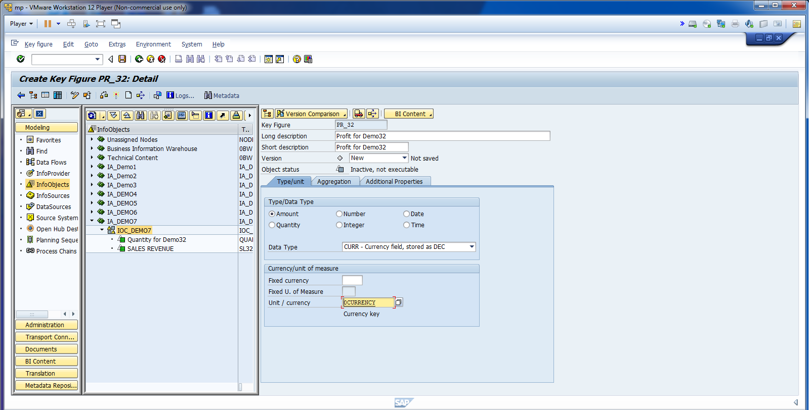
Cont.

Slide 14
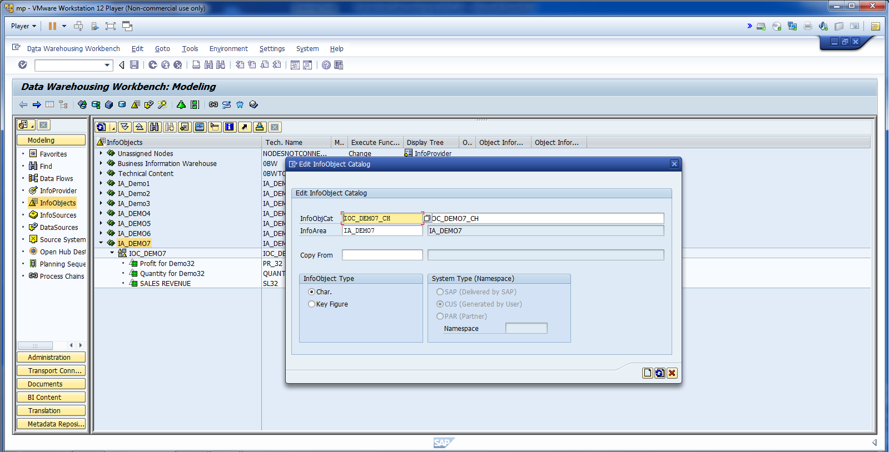
Create SID and PID Char. IO.

Slide 15
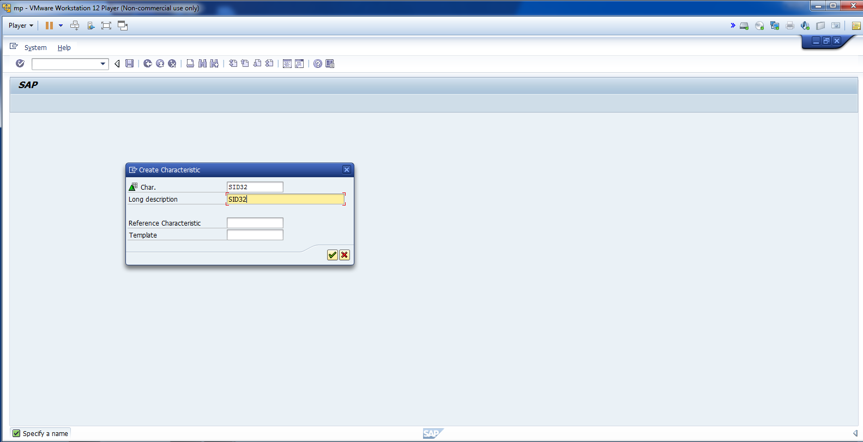
Create SID Char. IO

Slide 16
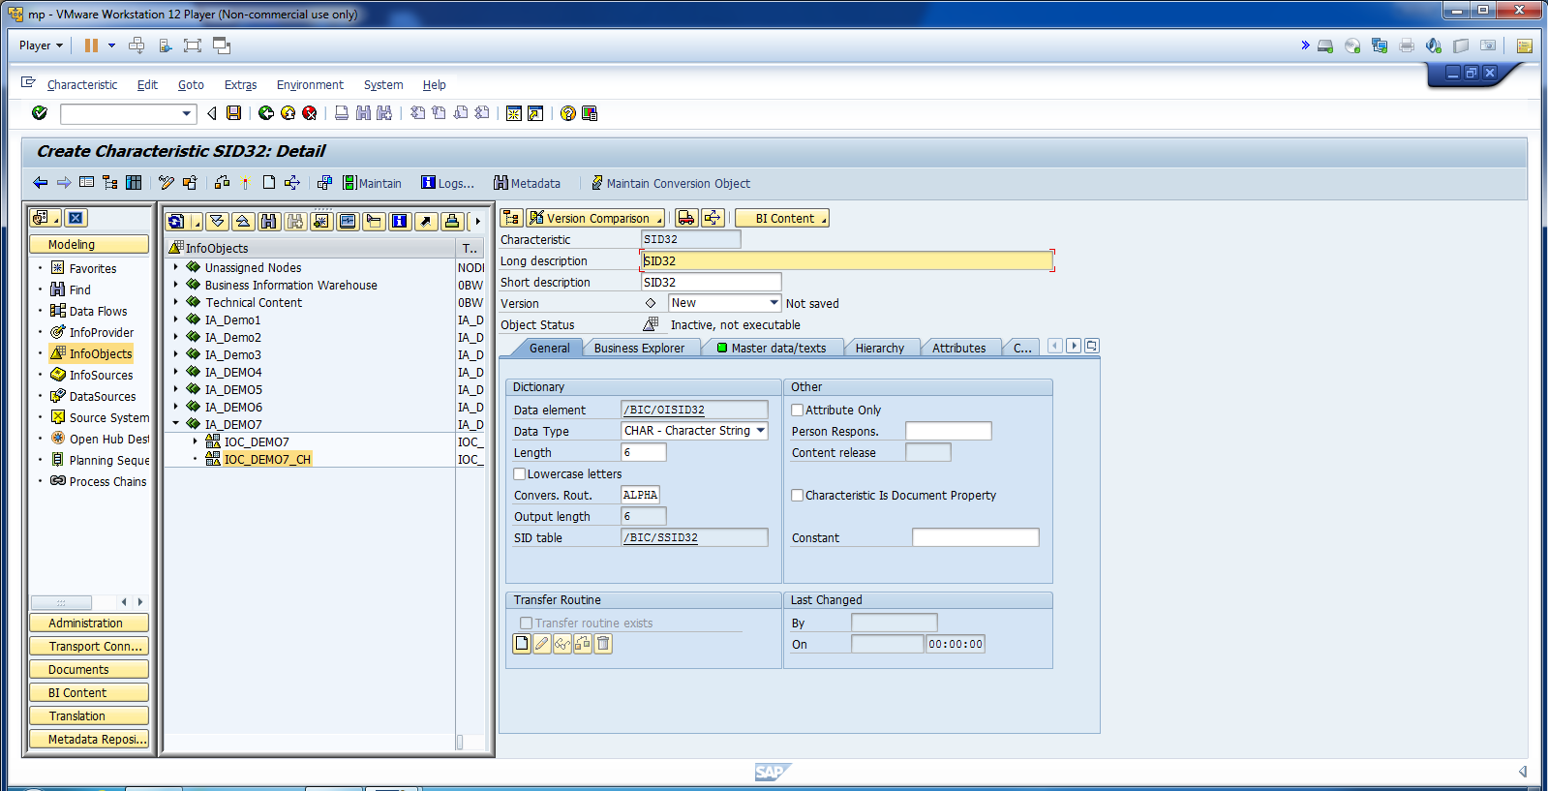
Create Char IO – SID. Update Gen Info.

Slide 17
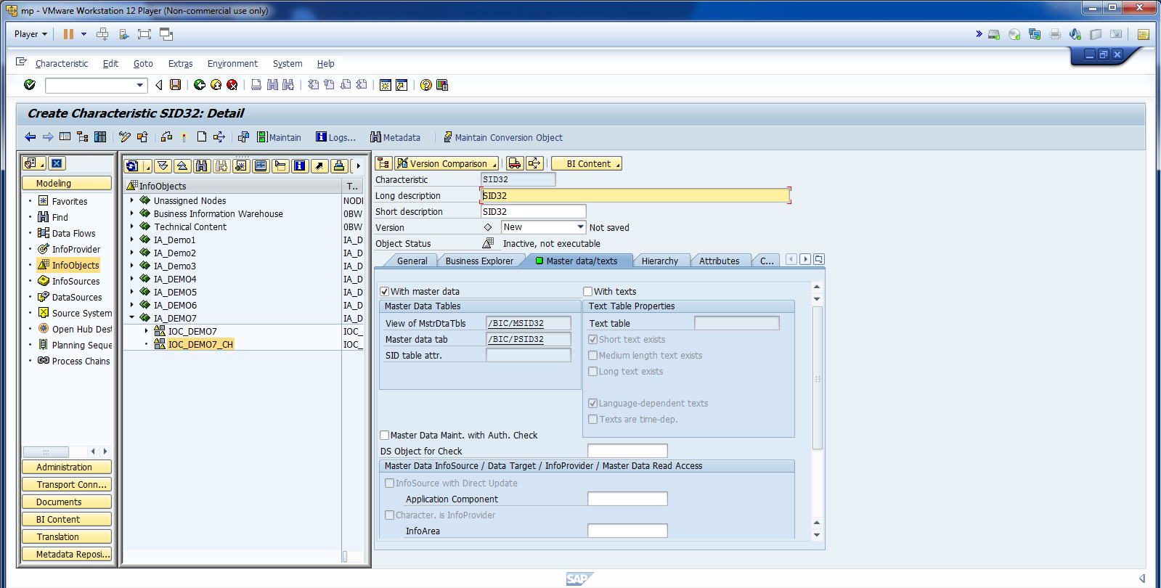
Create Object Without Text.

Slide 18
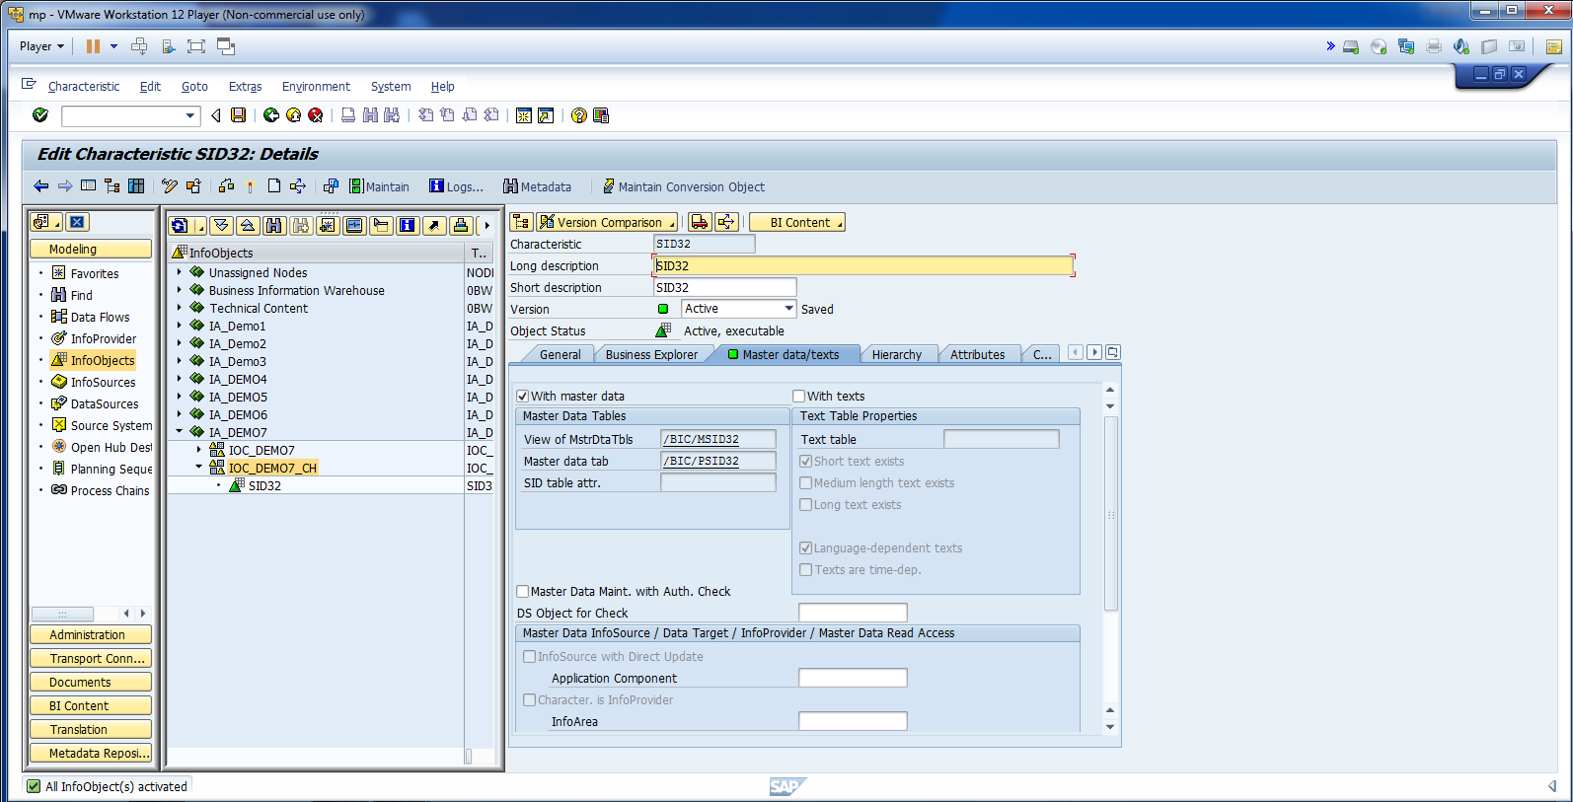
Activate IO.

Slide 19
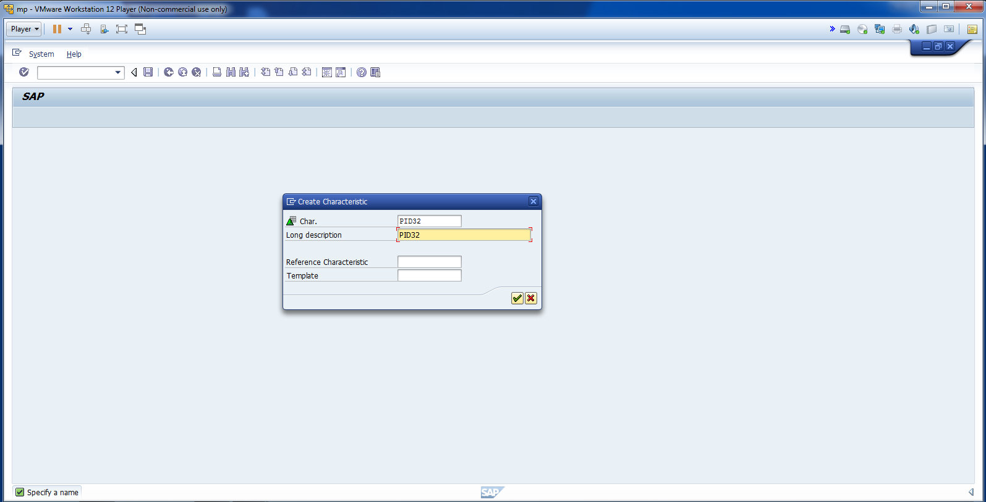
Create Another Char IO. – PID.

Slide 20
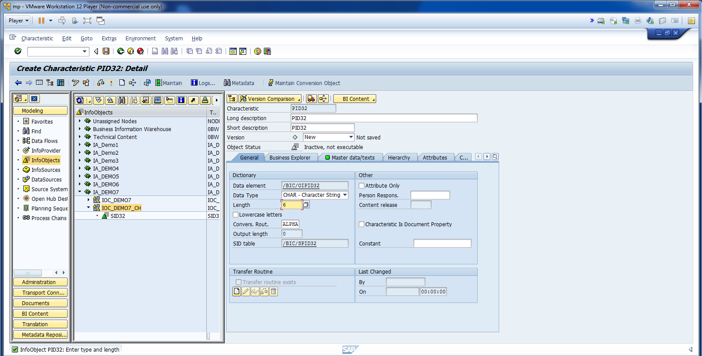
Update General Info. Remove with Txt.

Slide 21
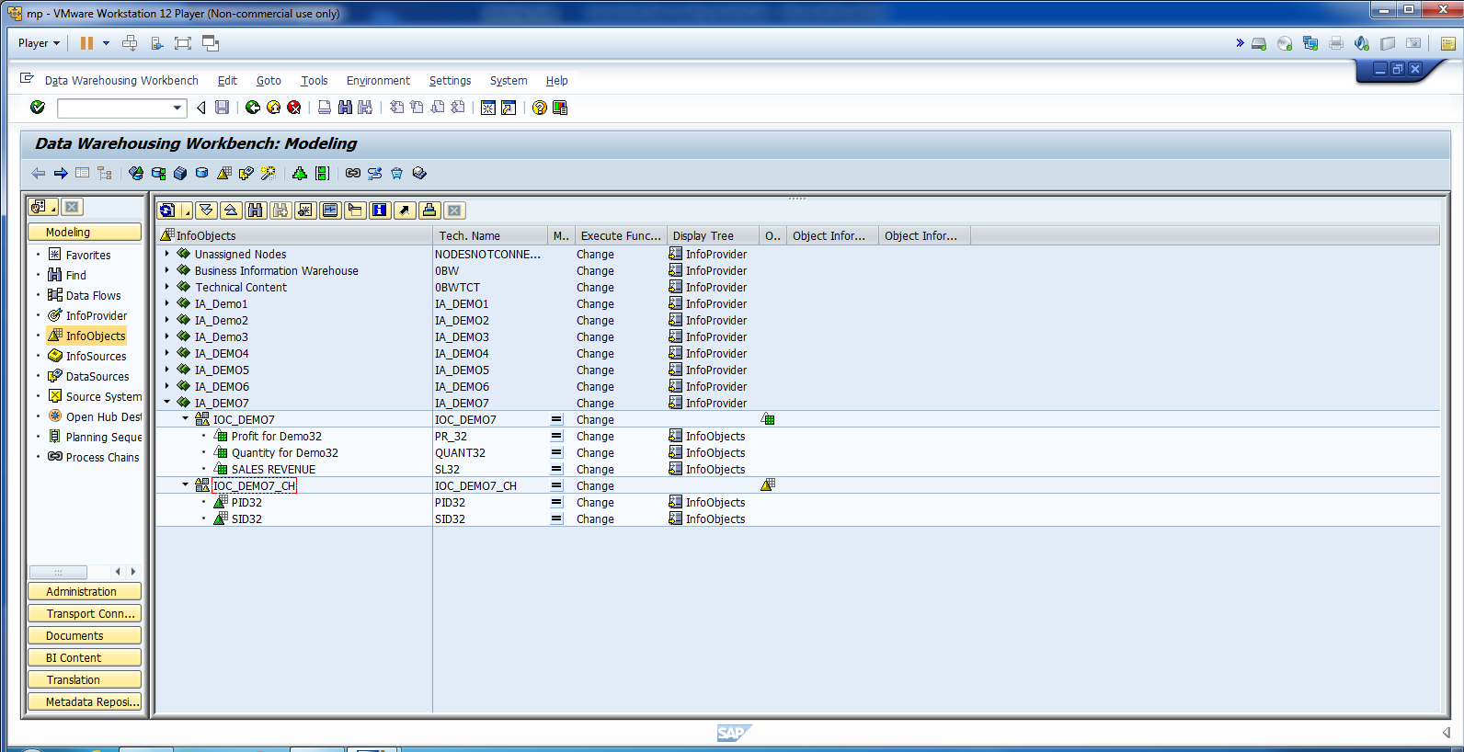
Final structure should look like below snapshot.

Slide 22
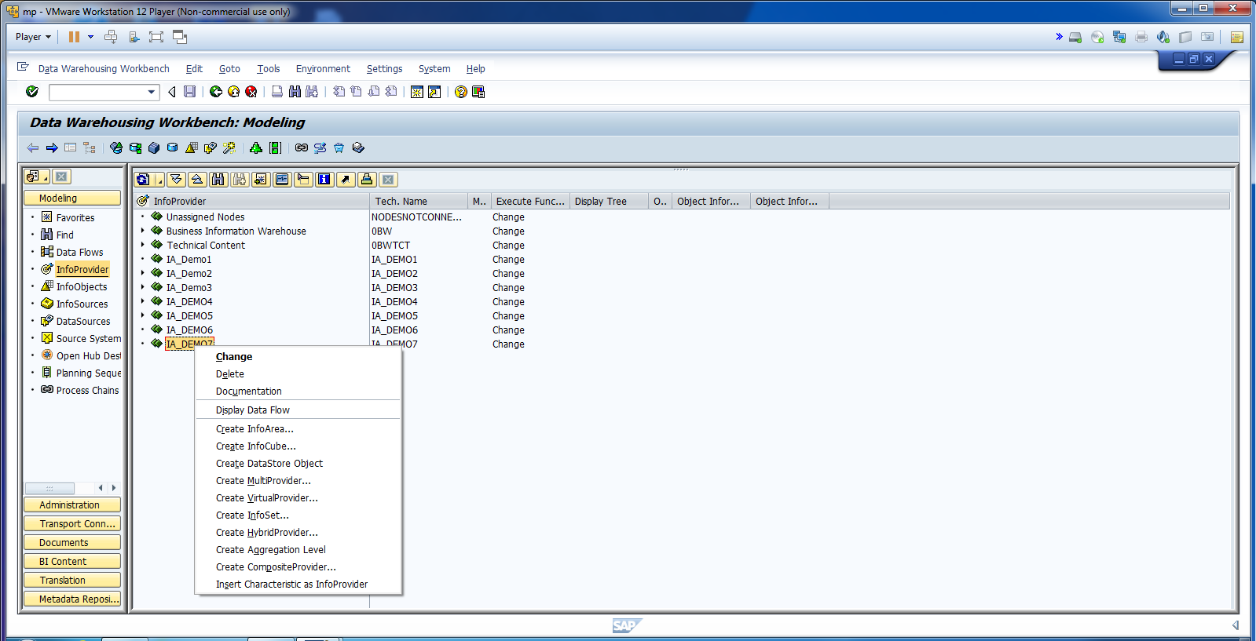
Now, lets create Data Target.

Slide 23
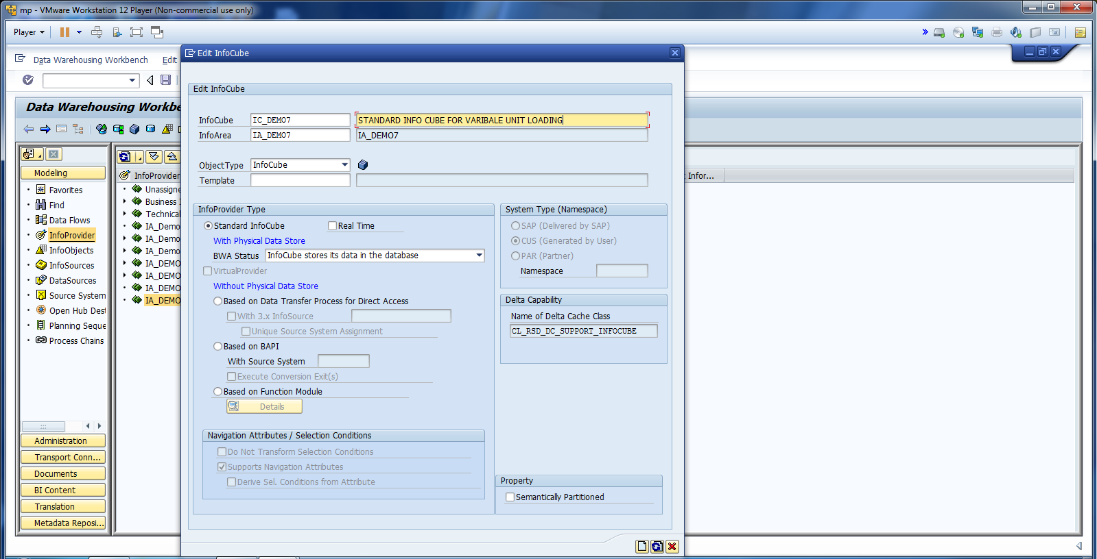
Update Info Cube.

Slide 24
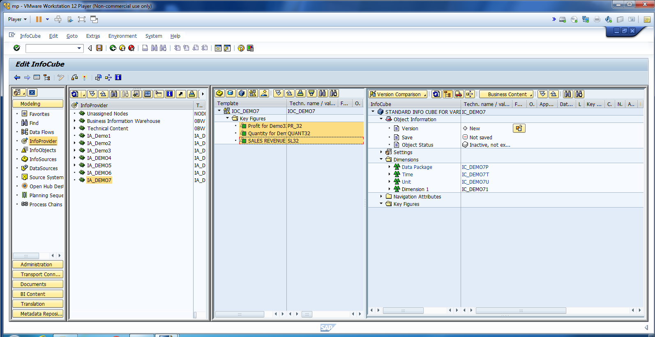
Add KIO.

Slide 25
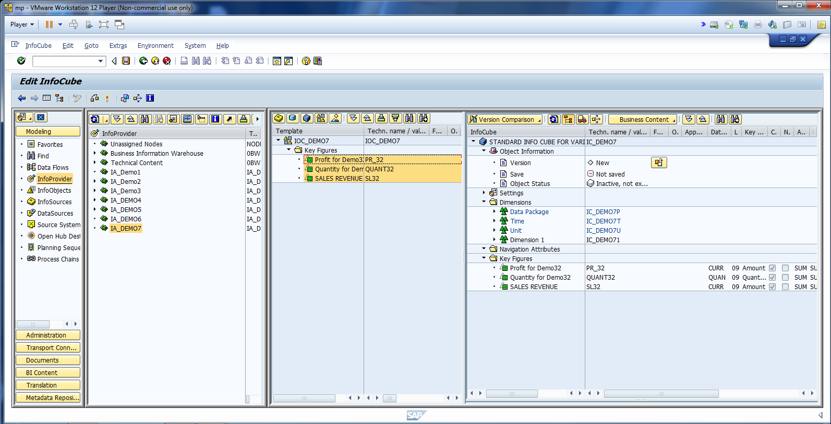
Cont.

Slide 26
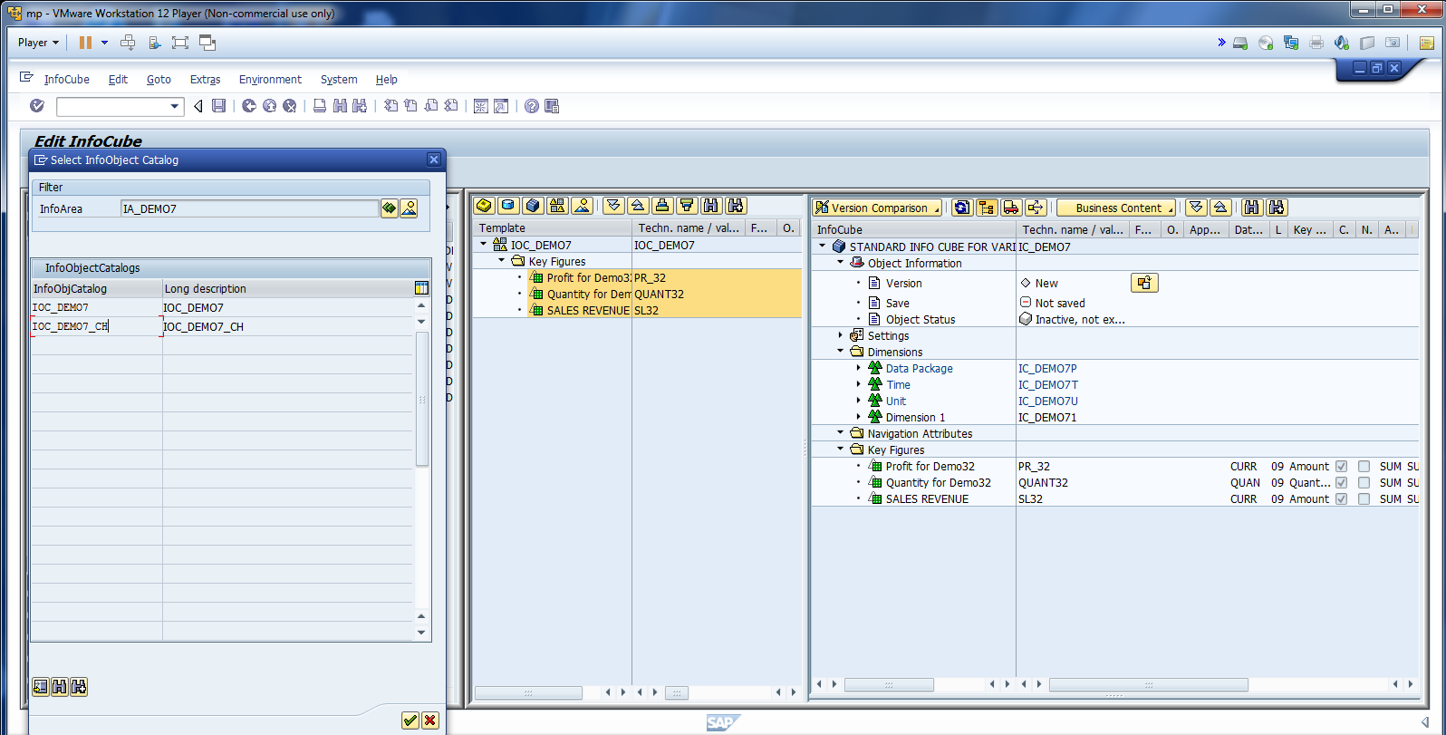
Add CIO.

Slide 27
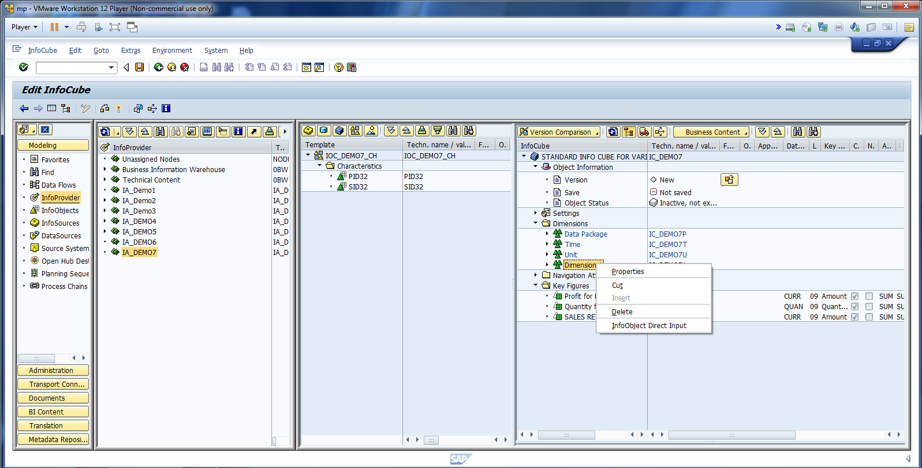
Rename Dimention_1 to Sales Dim.

Slide 28
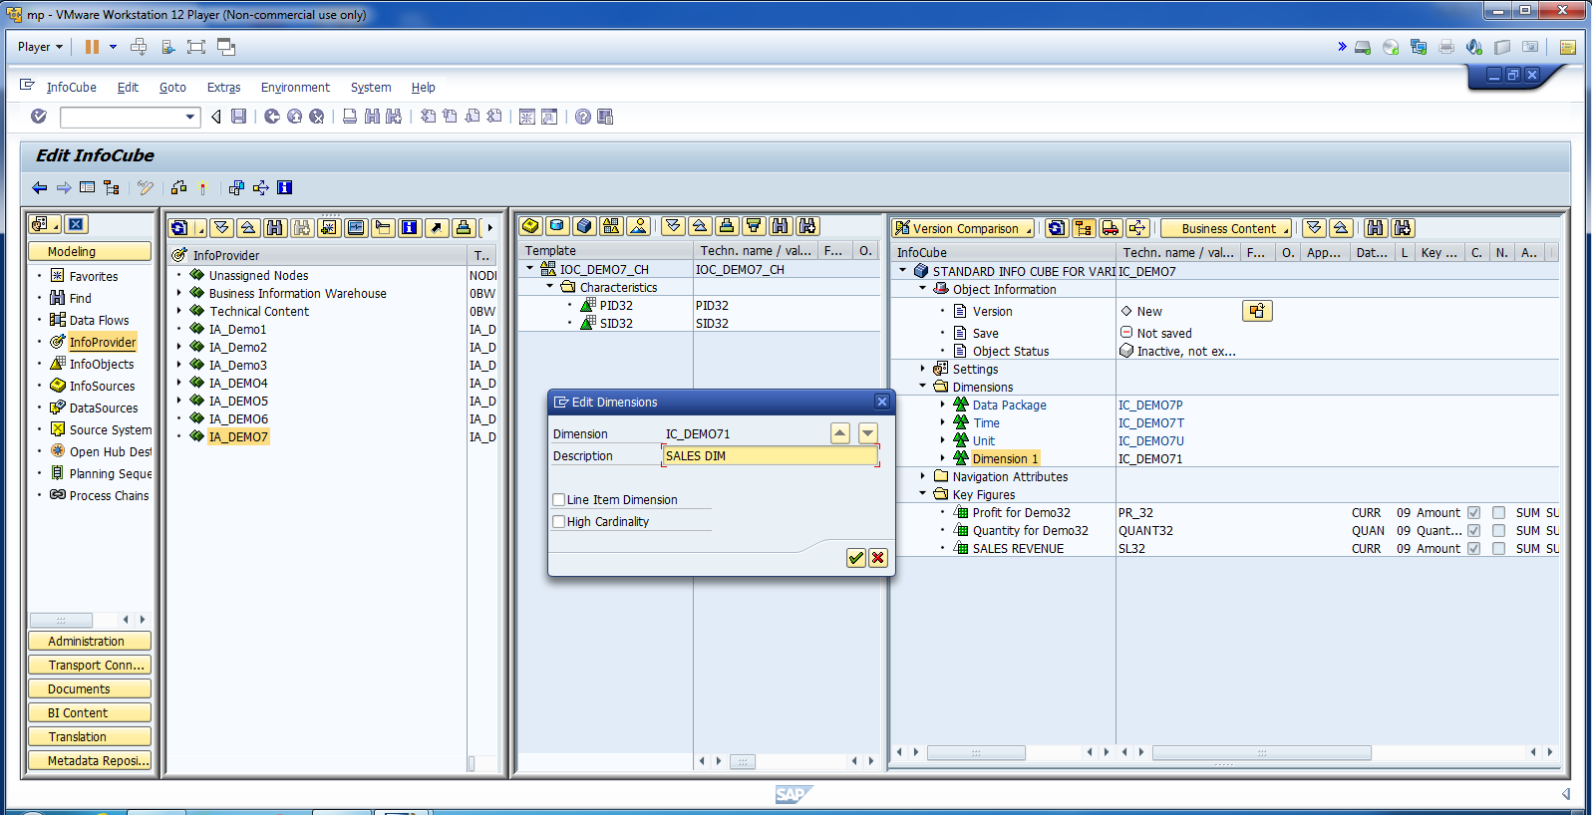
Cont.

Slide 29
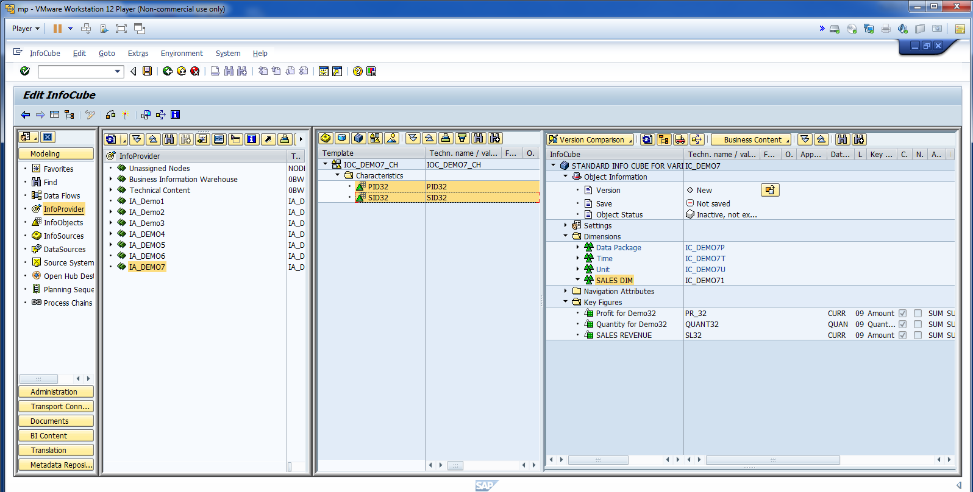
Cont. Add CIO.

Slide 30

Cont.

Slide 31
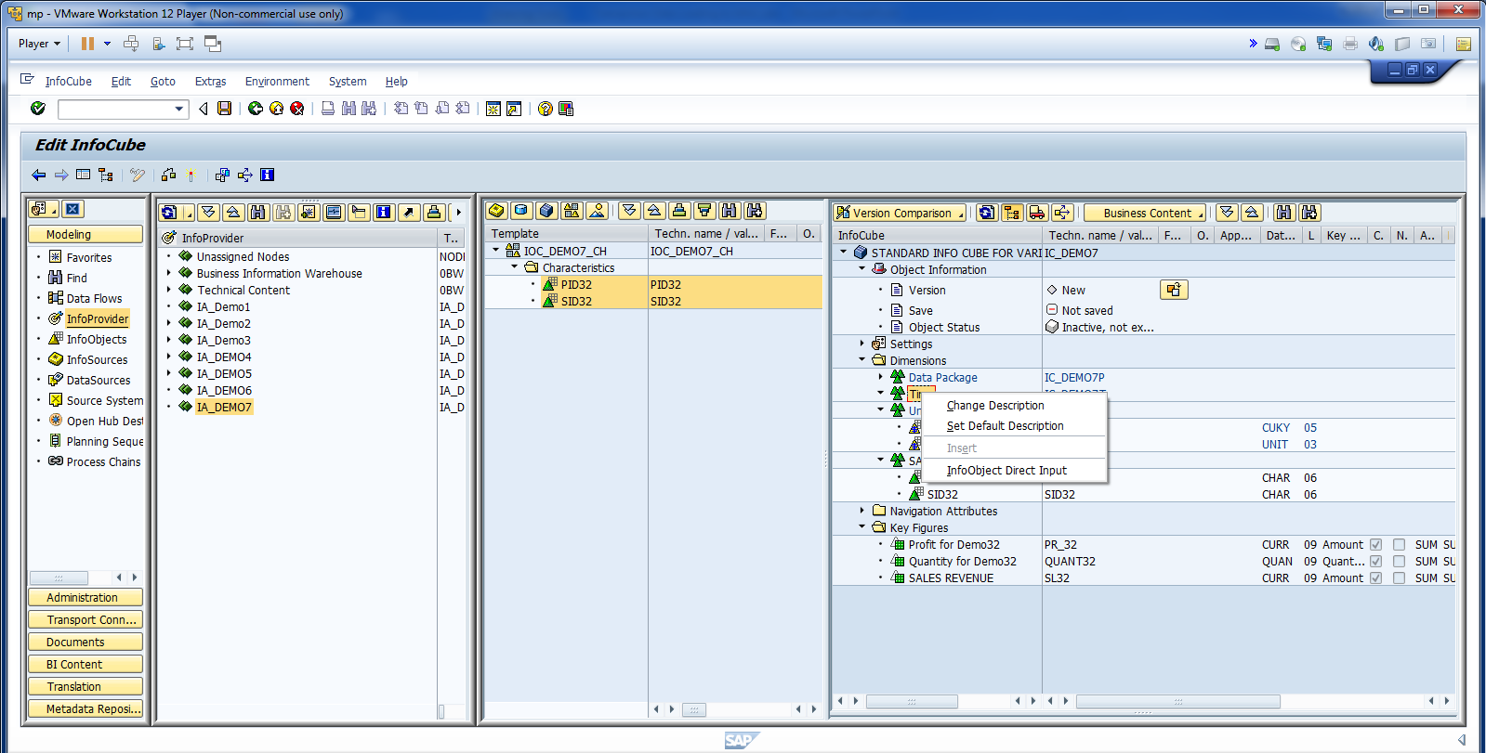
Now Add Time IO.

Slide 32
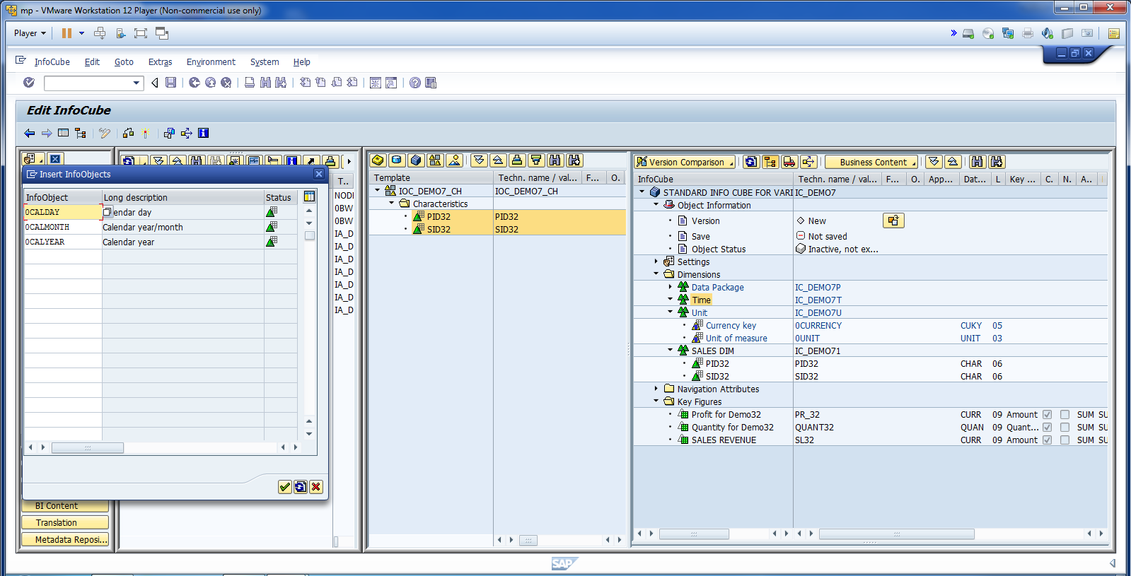
Cont.

Slide 33
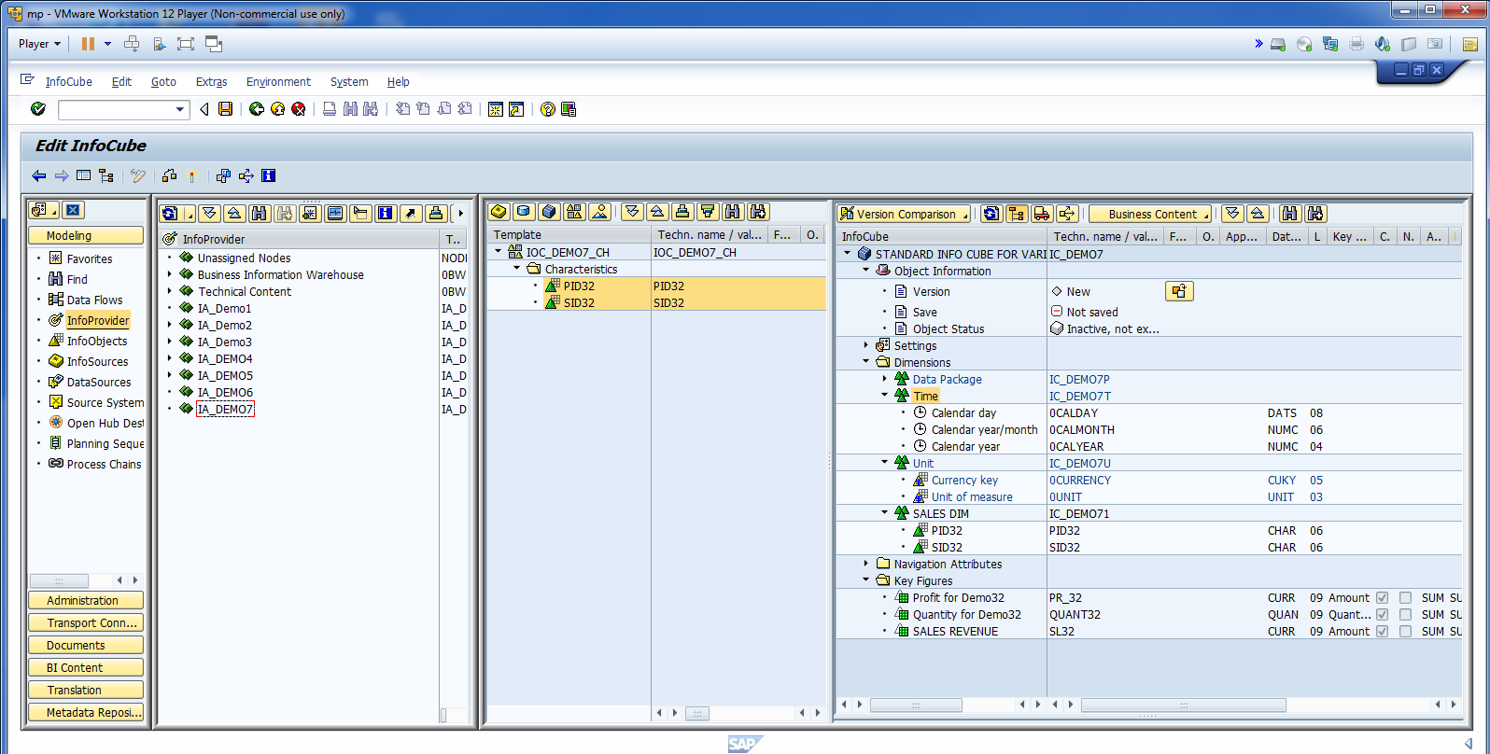
Click on Check for any Error.

Slide 34
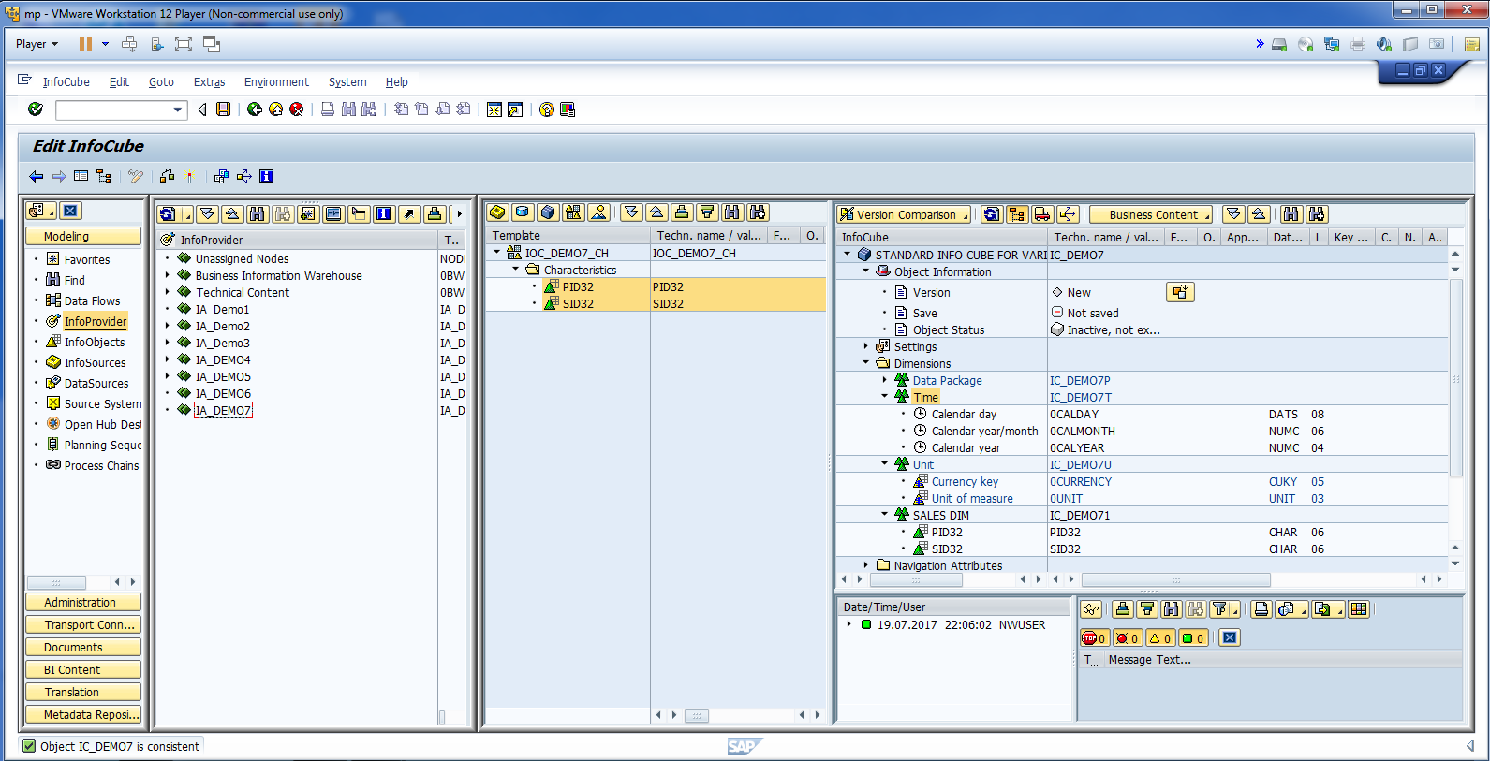
Make sure that data is consistent.

Slide 35
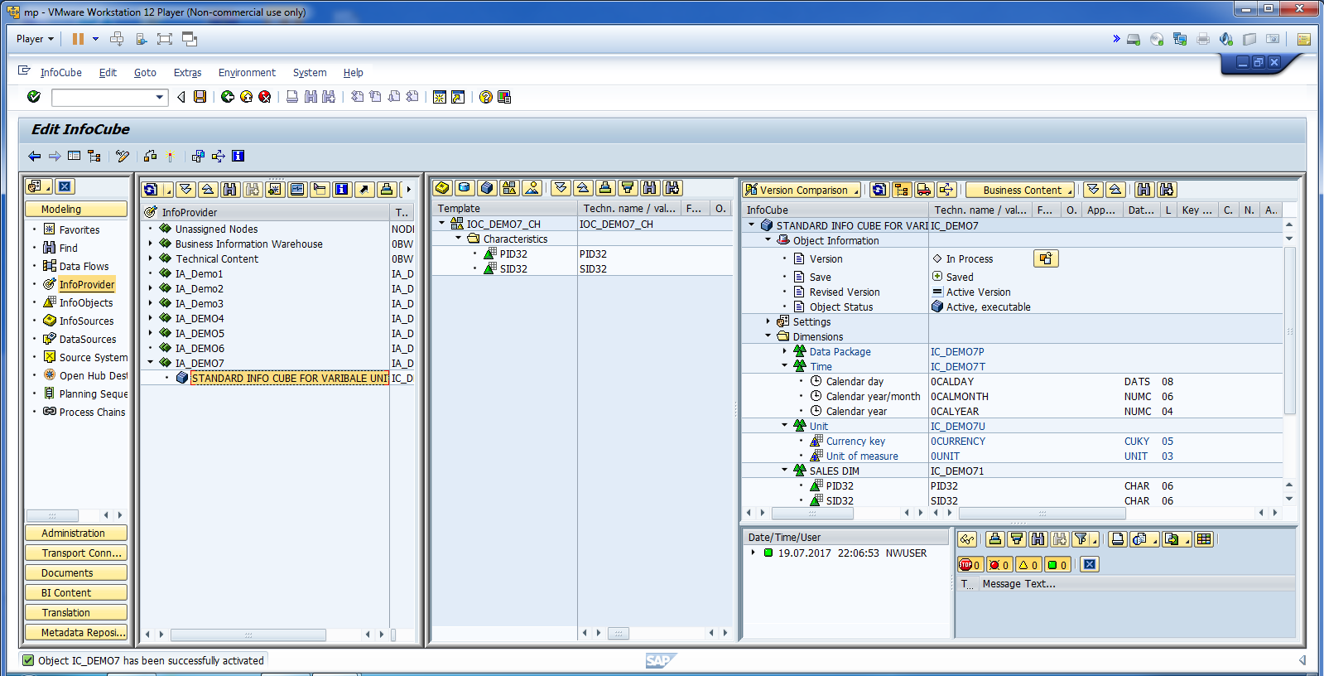
Activate Info Cube.

Slide 36
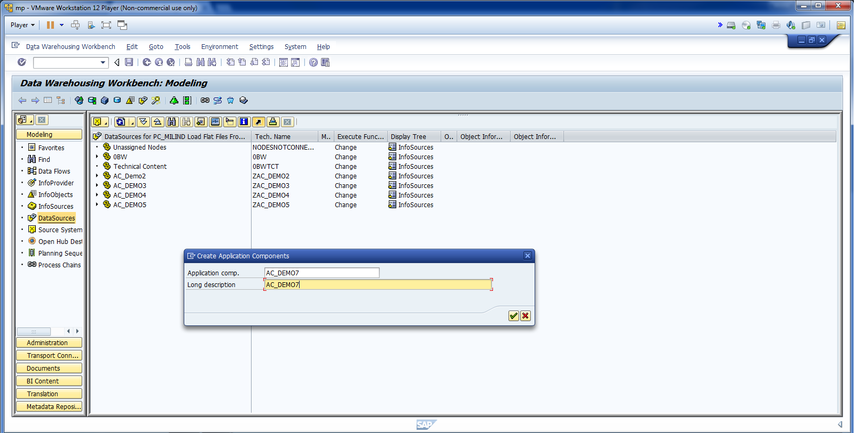
Now Create AC.

Slide 37
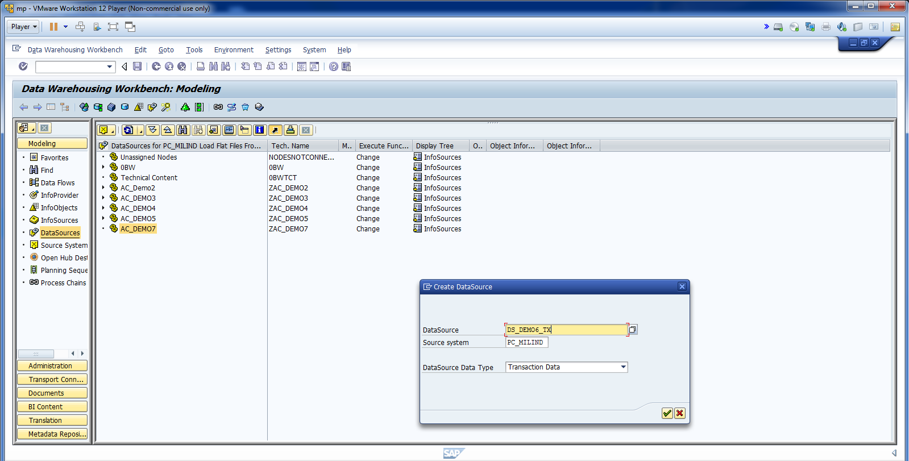
Cont.

Slide 38
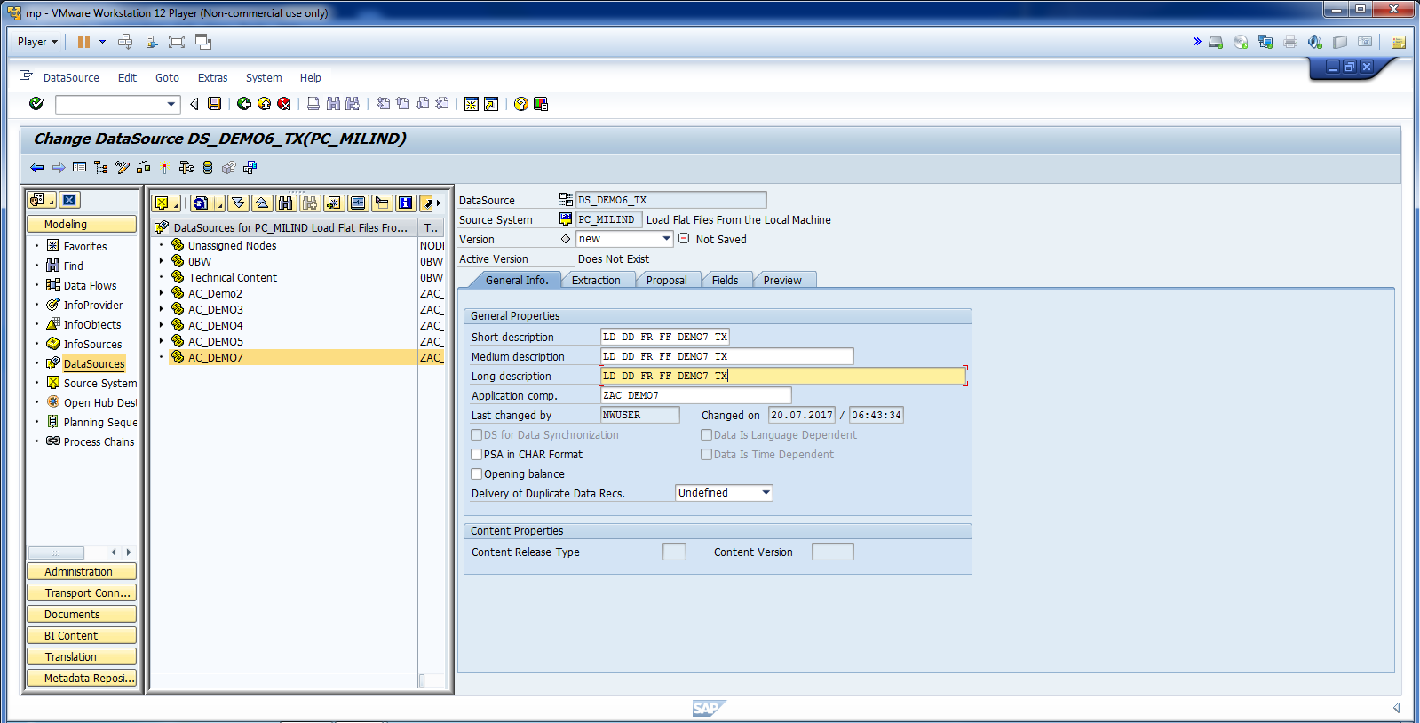
Create DS.

Slide 39
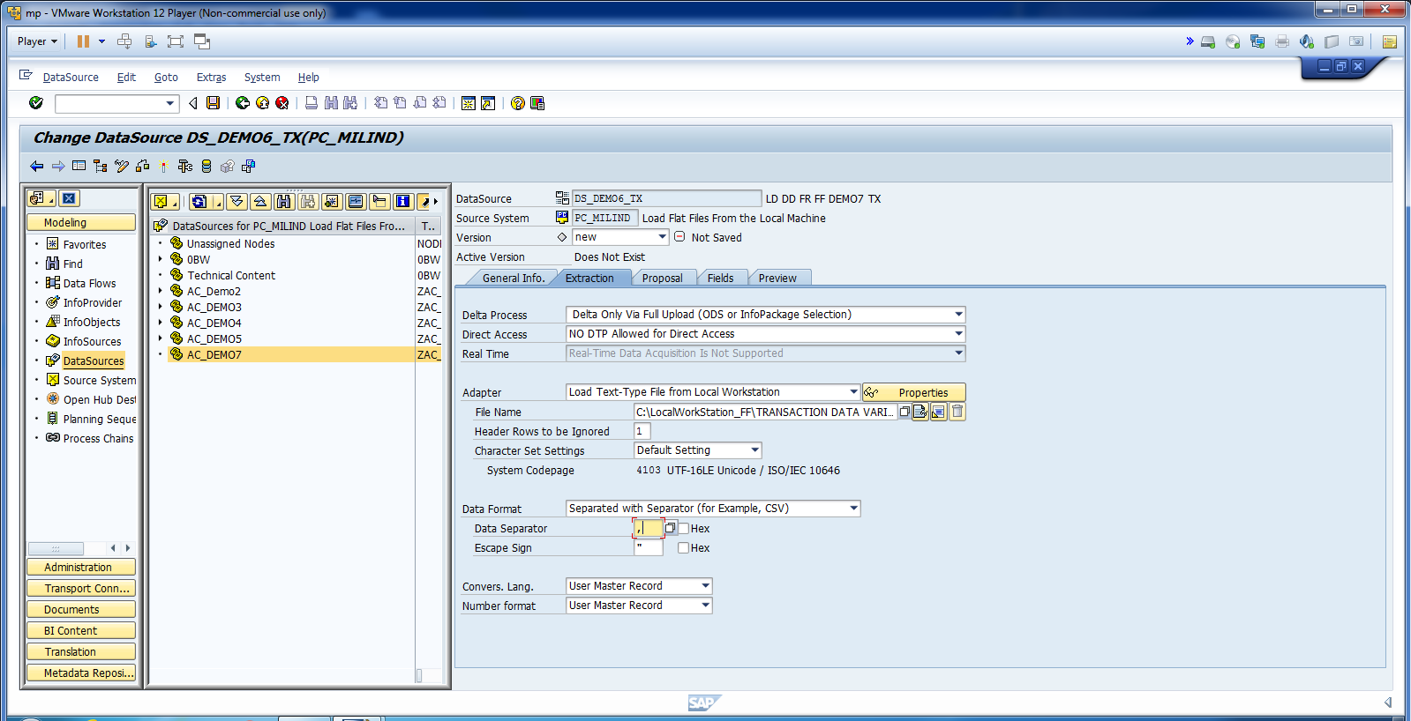
Update Extraction.

Slide 40
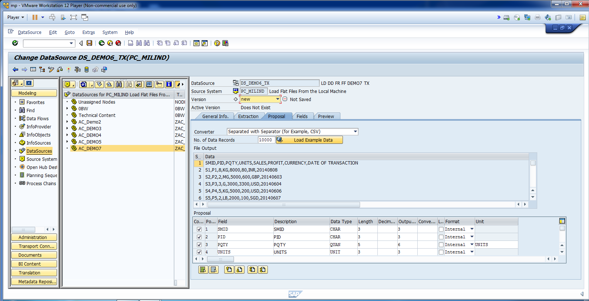
Cont.

Slide 41
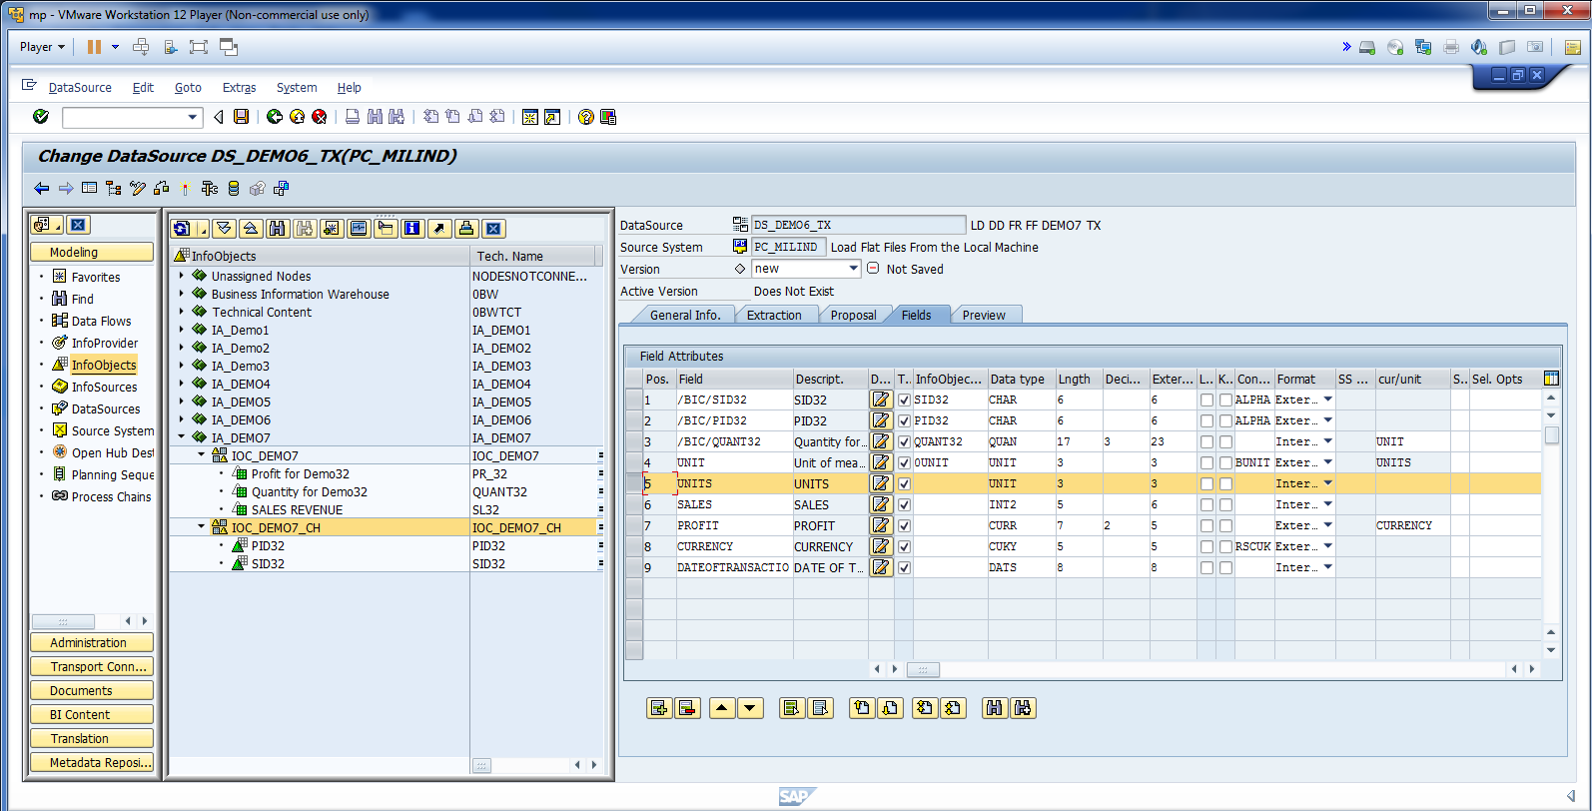
Map Fields. Delete Units tab.

Slide 42
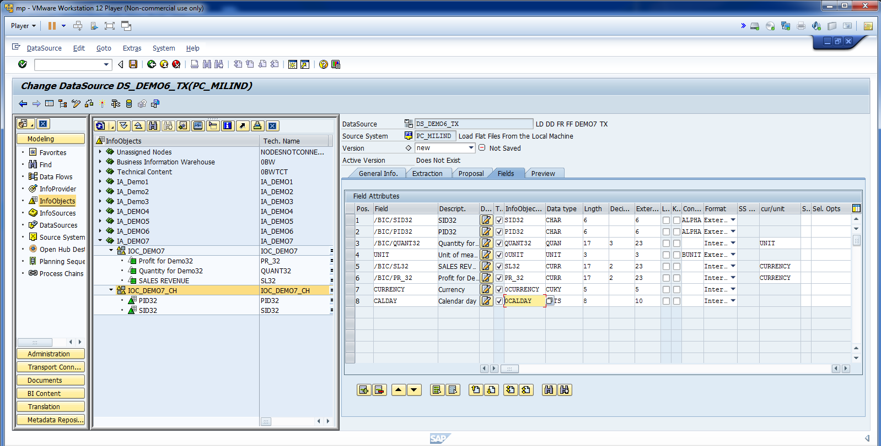
Cont.

Slide 43
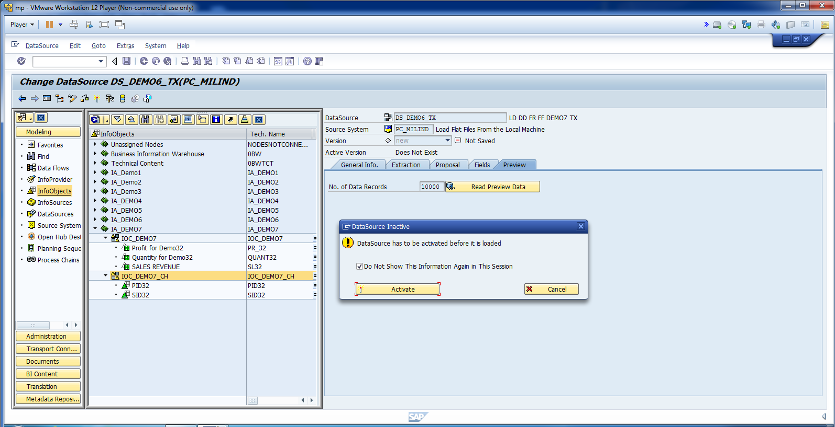
Activate DS.

Slide 44
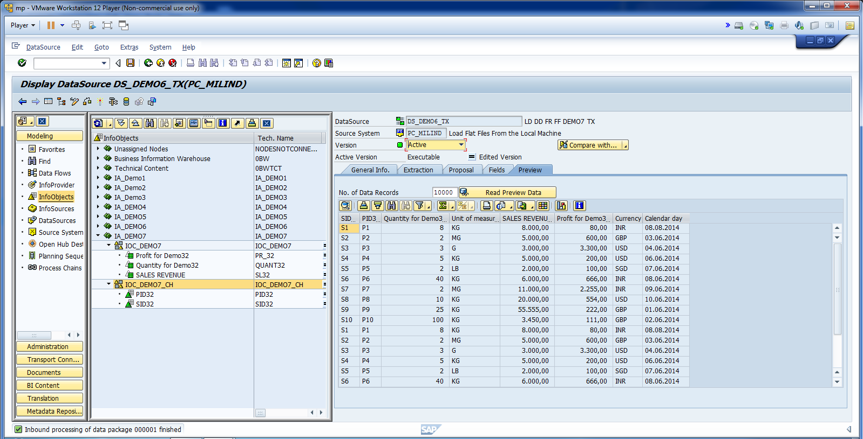
Read Data Preview.

Slide 45
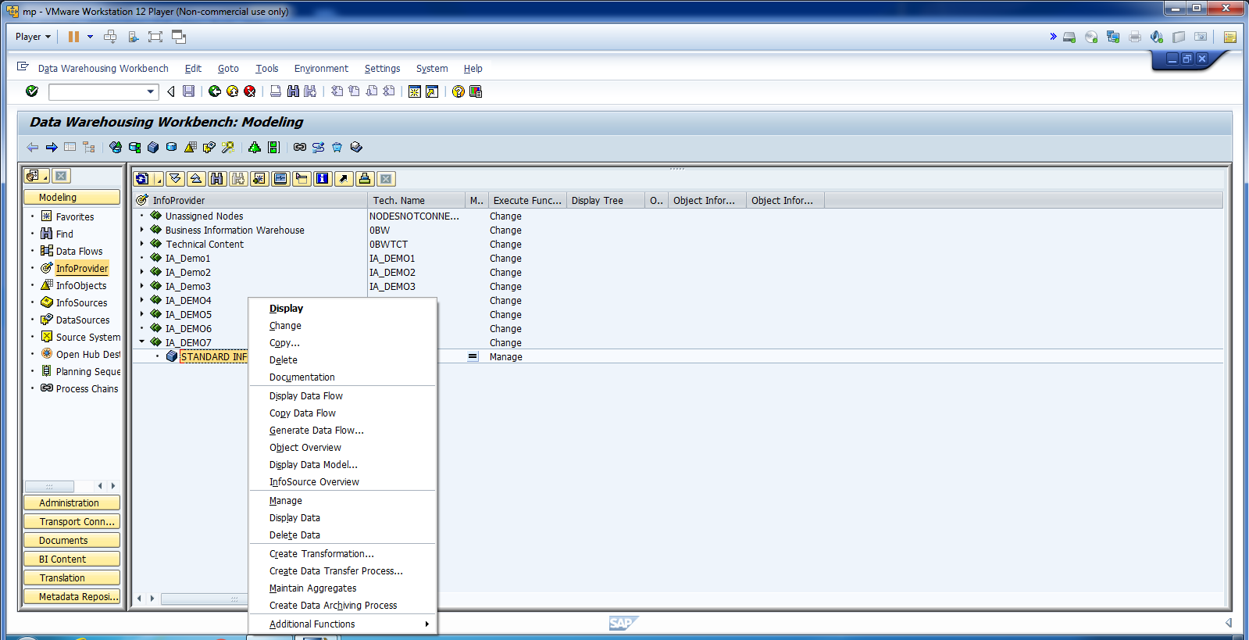
Create Transformation.

Slide 46
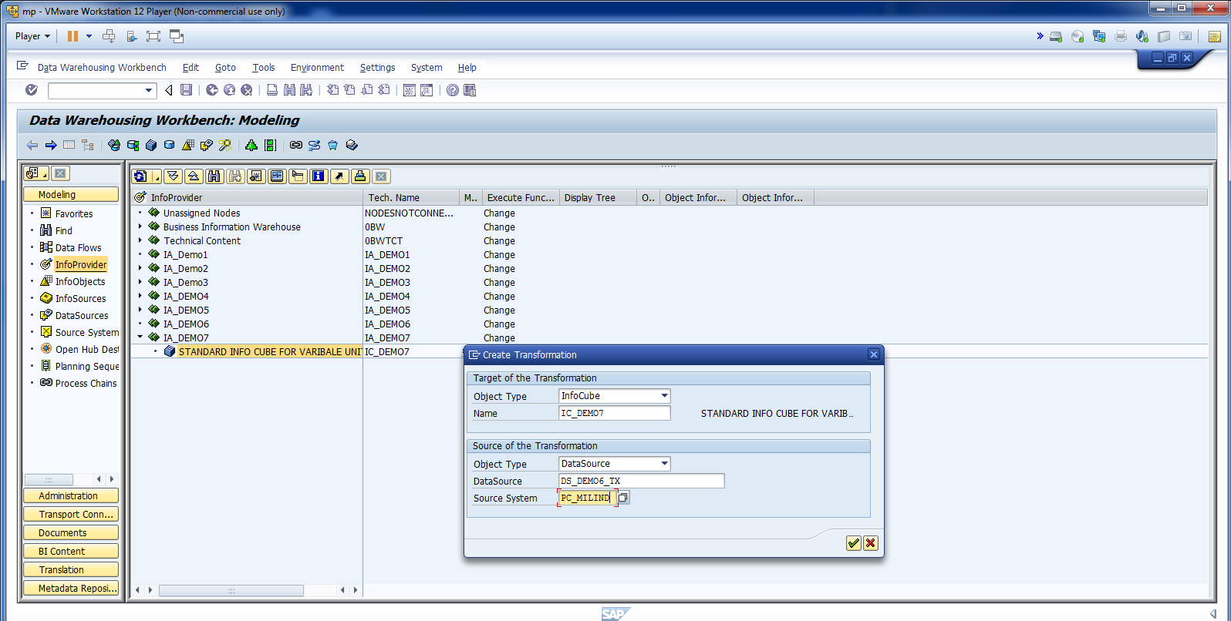
Cont.

Slide 47
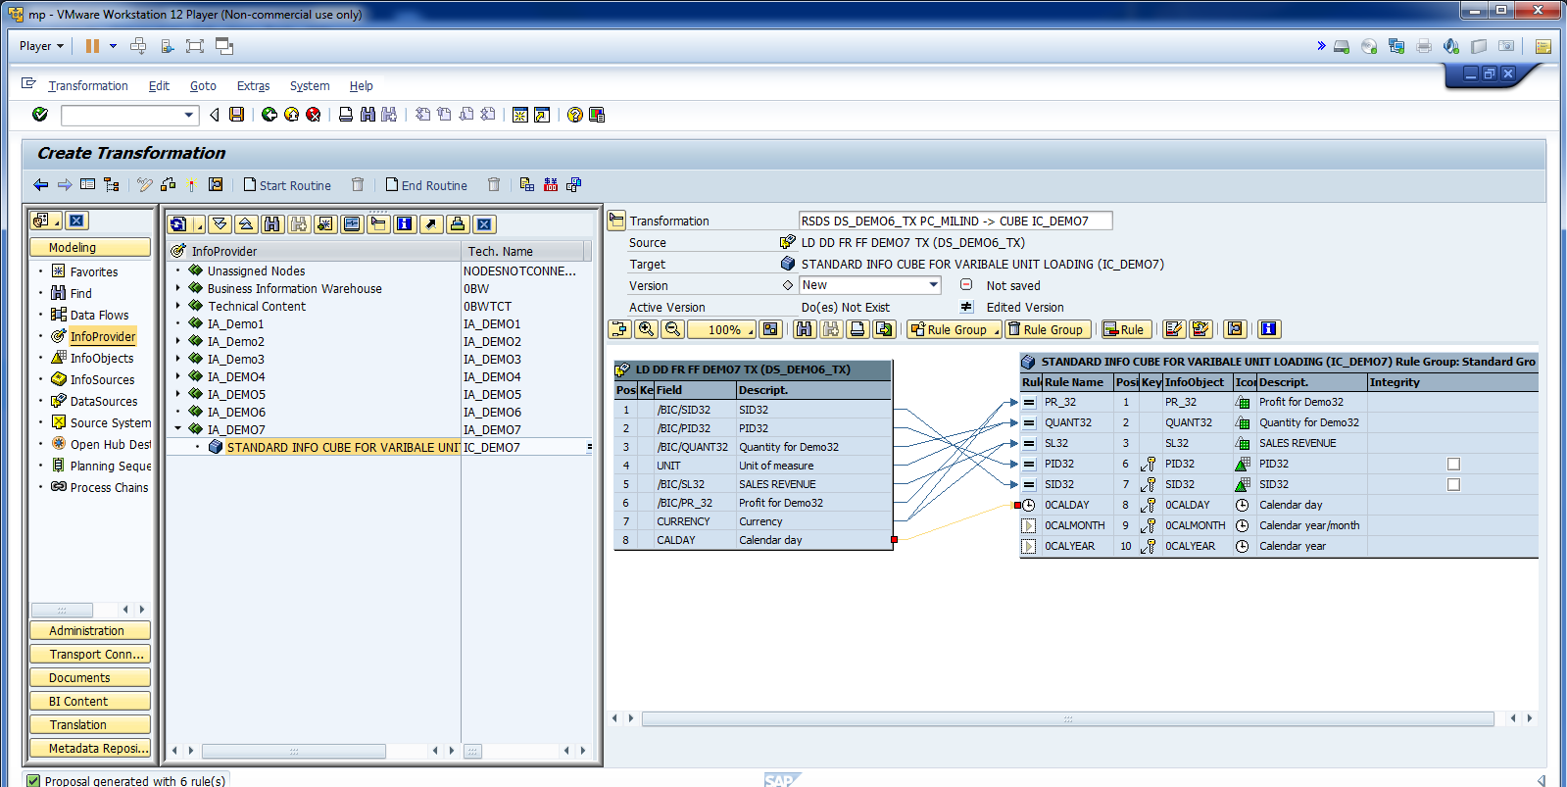
Make sure all mapping is correct.

Slide 48
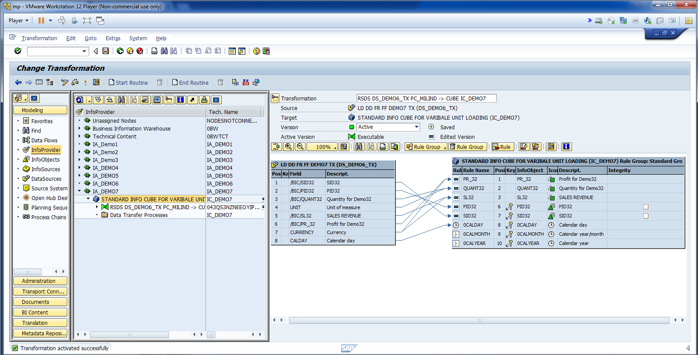
Cont. Activate Transformation.

Slide 49
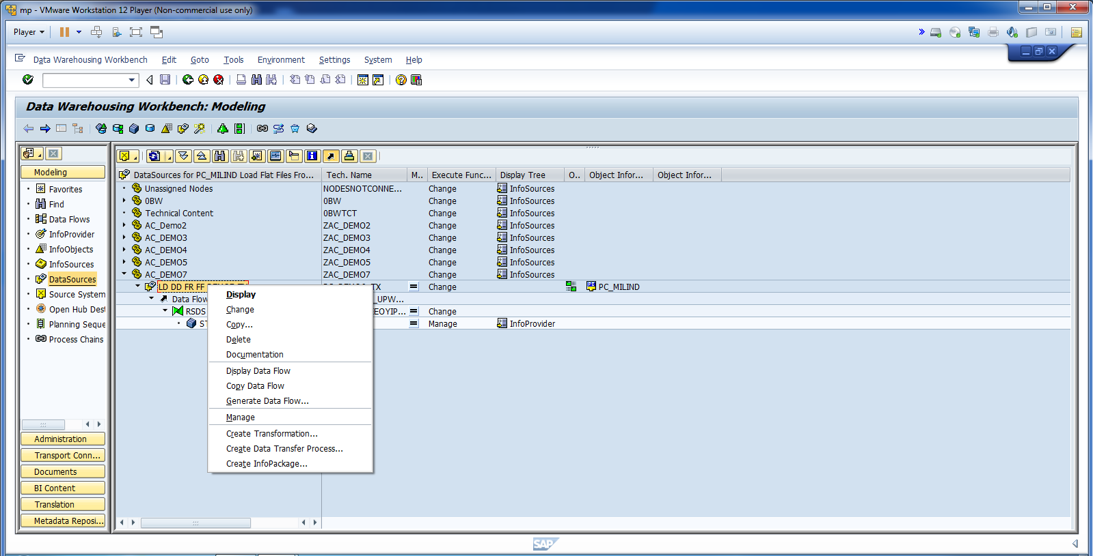
Create Info Package.

Slide 50
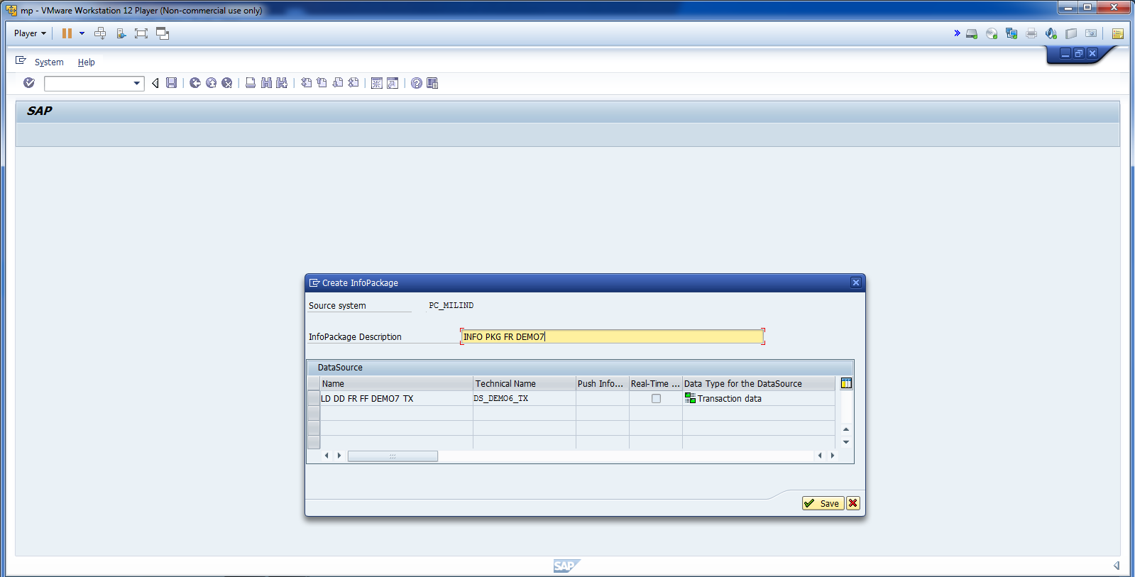
Save INFO PKG.

Slide 51
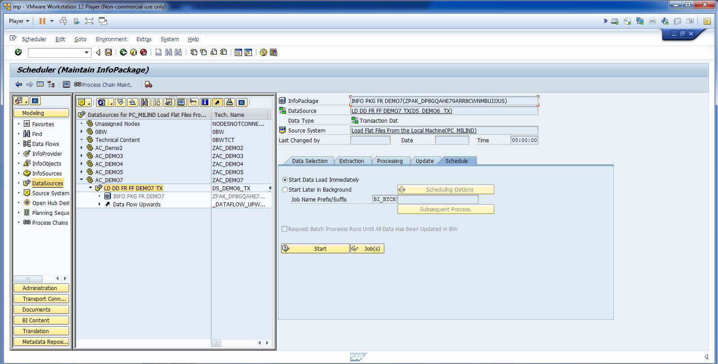
Start Loading Data to PSA.

Slide 52
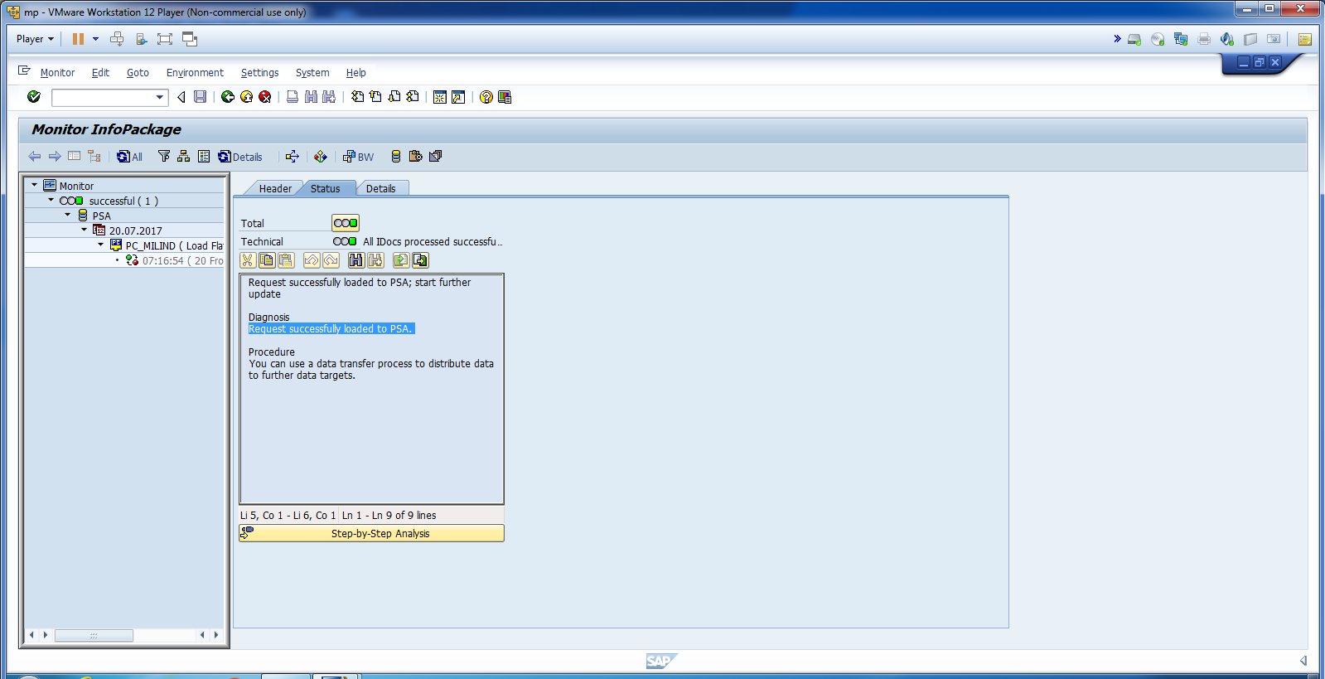
Monitor Data in PSA.

Slide 53

Check Data in PSA.

Slide 54

Start DTP.

Slide 55

Cont.

Slide 56

Change Extraction Mode to Full.

Slide 57

Activate DTP and Click Execute.

Slide 58

Click Yes to Monitor.

Slide 59

All the records loaded successfully.

Slide 60

Click ADT.

